Slide 1
Citizens for safety
Building urban safety through citizens participation

Slide 2
Citizens for safety – FRAME OF the PROJECT
EU Strategy for the Baltic Sea Region
PA Secure

Slide 3
Citizens for safety – FRAME OF the PROJECT
Action: Enhance a joint urban safety and prevention approach in the Baltic Sea region by:
rising awareness
enhancing prevention
transnational cooperation

Slide 4
Citizens for safety – the Flagship Project
Effective learning and exchanging best practices on urban safety through a local city network
The network fosters urban safety exchanges throughout Baltic Sea region on locally-developed know-how strategies, shares experiences, analyzes functions and activities of municipalities and develops new safety management in the cities more oriented towards the needs of local communities. Lead: Union of the Baltic Cities Commission on Local Safety.

Slide 5
Citizens for safety - Main project
the need for the main project
what has been done what needs to be done
description of the main project
main project outcomes
geographical scope of the main project

Slide 6
Citizens for safety - Initial partnership
Gdansk
Vilnius
Liepaja

Slide 7
Citizens for safety – SOURCE of financing
Seed Money Facility Mechanism
Investitionsbank Schleswig-Holstein

Slide 8
Citizens for safety - state of play
Establishing initial cooperation
Collecting data related to feeling of safety
Preparation of survey
Overview of similar projects

Slide 9
Citizens for safety - Planning main stage project
Creation of a network of municipalities interested in encouraging citizens to participate in providing safety
Brainstorming session of tools and activities for main stage project
Assessment session of tools and activities for main stage project
Planning activities for main stage project
Determining functionality of web-based tools
Formation of the task group for preparing grant application for main stage project

Slide 10
Citizens for safety - Report on funding possibilities
Searching for funding possibilities on EU Level
Searching for funding possibilities on national level
Searching for other funding possibilities

Slide 11
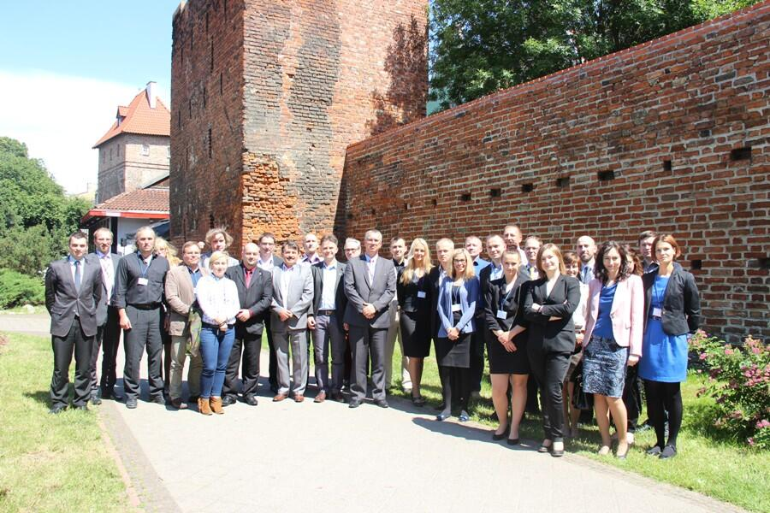
Meeting in Gdańsk 25-27 June 2014

Slide 12
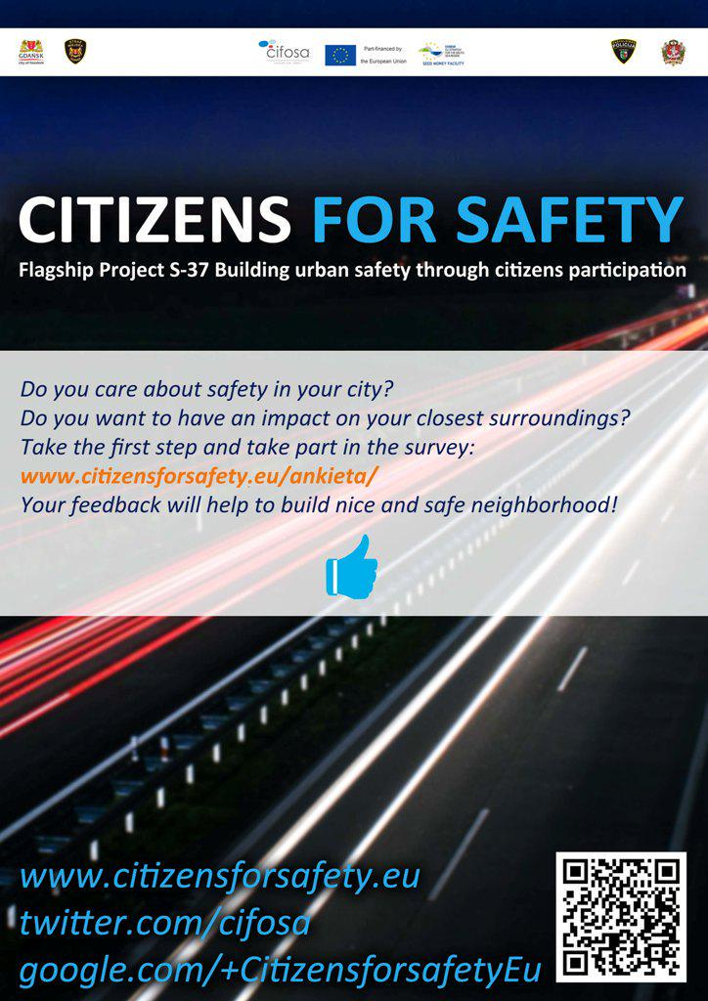
Do you feel safe? Survey amongst citizens
Notes:
Gdańsk: 266
Liepaja: 163
Vilnius: 184

Slide 13
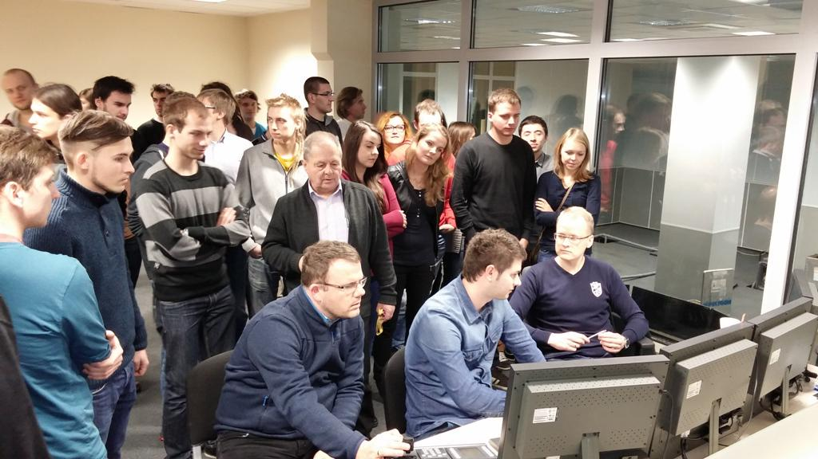
COOPERATION WITH URBANLAB

Slide 14
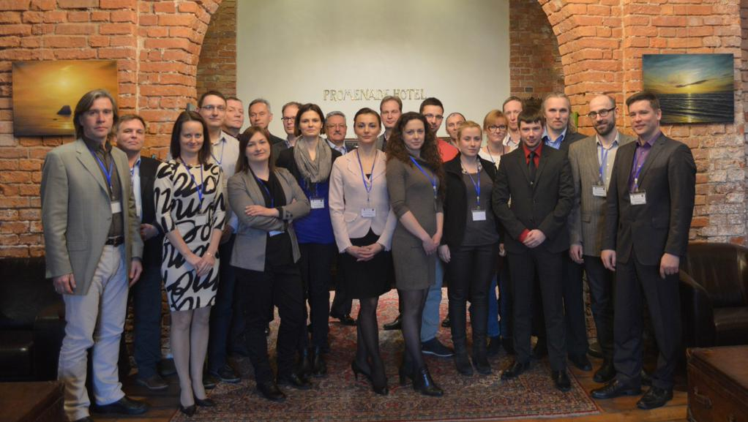
Meeting in Liepaja 19-20 February 2015

Slide 15
Citizens for safety - Expanded partnership
UBC
Gdańsk
Liepaja
Vilnius
Tallinn
Riga
Sosnowiec
EFUS
Jelgava
Słupsk
Political Critique
Jõhvi
Tukums
ACCUS

Slide 16
Citizens for safety - budget & timeframe
40 434 EUR total amount of the project
up 85% of total cost covered by EU grant
end date project activities 2 March 2015

Slide 17
Communications
www.citizensforsafety.eu
Twitter/CiFoSa
Yammer/CiFoSa
Google+/CiFoSa

Slide 18
Future plans
Strengthen the cooperation between municipalities, academia and ngo’s around BSR
Figuring out and introducing soft project activities amongst citizens
Integration of smart systems between the project cities (plugins for CiFoSa)

Slide 19
Contact details
Project Manager:
Milosz Jurgielewicz
m.jurgielewicz@sm.gda.pl
+48 508 037 248

