Slide 1
Meeting of UBC’s Communications Network during UBC Executive Board meeting 11 June 2015, Dolina Charlotty, Poland Irene Pendolin / Anna Kotaviita Communications Manager irene.pendolin@ubc.net / anna.kotaviita@ubc.net +358 40 848 6242

Slide 2
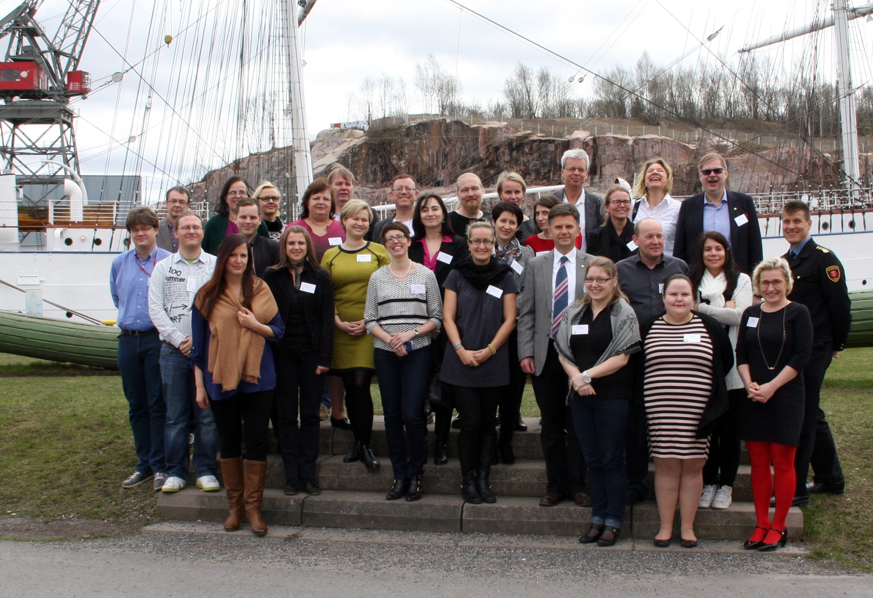
Meeting of UBC’s Communications Network during UBC Executive Board meeting 11 June 2015, Dolina Charlotty, Poland Irene Pendolin / Anna Kotaviita Communications Manager irene.pendolin@ubc.net / anna.kotaviita@ubc.net +358 40 848 6242

Slide 3
Feedback on the seminar in Turku
Participants
33 participants from13 cities: Elva, Gävle, Jelgava, Jyväskylä, Klaipeda, Kolding, Kotka, Liepaja, Pori, Trelleborg, Turku, Umeå, Växjö.
4 commissions: Cultural Cities, Safe Cities, Sustainable Cities, Youthful Cities.
Report to be given to UBC Executive Board
Positive outcomes
Useful, valuable and overall a very good seminar
Good beginning for developing UBC communications which can formulate into a tool that every member city can benefit from
Seminar clarified the new UBC commissions and their tasks
Interesting lectures and discussions, everyone had the possibility to interact
“I had a lot of thought and knowledge to go home with and the seminar made me think more about my responsibility and the responsibility of each member city.”

Slide 4
Feedback on the seminar in Turku
To be developed in future seminars
Workshops could have been divided for two days and arranged differently – the group was large to have discussions in.
Could have been more participants and more time.
Member cities should have sent more people to the seminar who are directly working with the field. Participants were mixed, which can be a good thing, but then a lot of knowledge from the member cities in the particular field of the seminar is missed.
Instead of traditional workshops, online voting, live chats on the wall etc. could be explored, as well as using social media within the group.
Lectures were a bit long.

Slide 5
ubc.net development
Top 6 – based on seminar discussions and answers to questionnaire
Creating a more functional and clear design, layout and platform, better structure and user-friendliness – webpage is like a business card of the organisation
Creating a more modern and attractive visual look
Website should be mobile-friendly
News, results of UBC work done in the commissions and cities as well as upcoming events should be more visible – less static information and more action on the pages
Giving out clear messages what UBC is and how and why cities should join UBC
Creating an intranet

Slide 6
ubc.net development
Where we are at in Dolina Charlotty
Budget under review by the Presidium
If/when UBC’s visual look is renewed, it will encompass all the commissions
Until the renewal process starts, commissions should not invest too much resources/money in especially renewing their websites, print mediums etc.
Graphical Guidelines and instructions from the Secretariat
ubc.net working group
Carsten Adamsen (Kolding), Natalia Vecvagare (Liepaja), Satu Heikkinen (Jyväskylä)
Christina Karlsson (Växjö), Esa Linna (Jyväskylä), Agnieszka Ilola (Turku)
Others who are interested?
Secretariat personnel
Mainly online meetings/emailing + next session in GC in Gdynia 27–30 October 2015

Slide 7
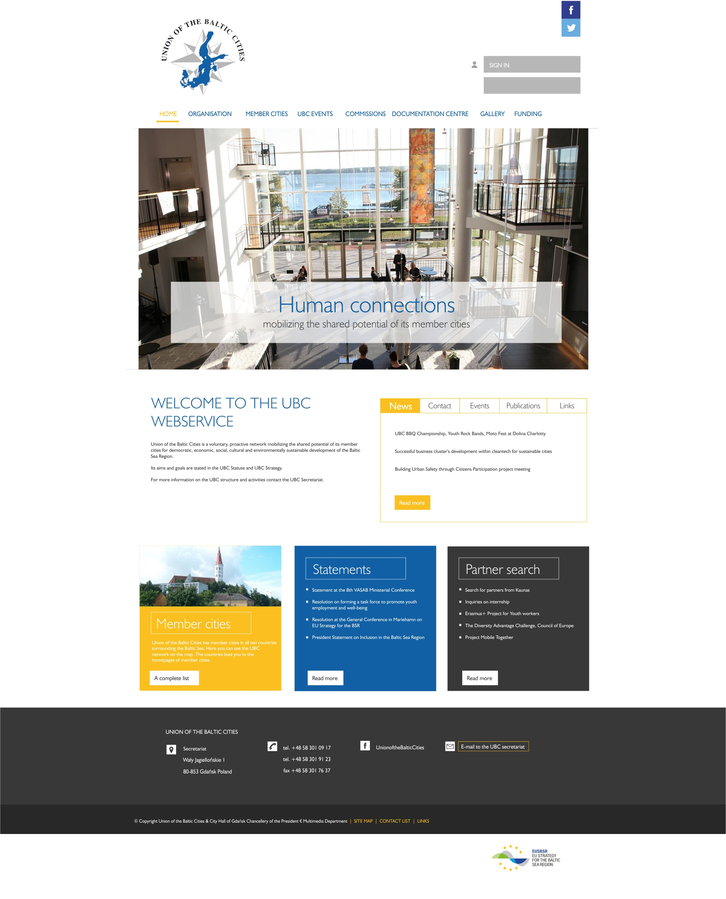
Intro: Future plans and possibilities – to be discussed in Learning Café 2

Slide 8
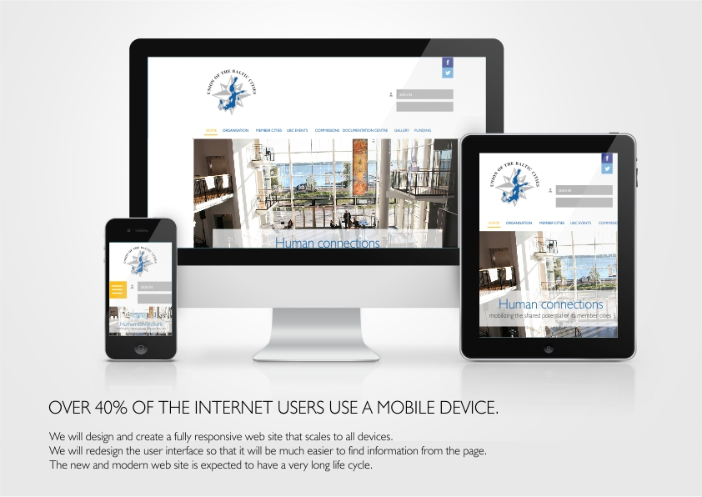

Slide 9
UBC communications and marketing renewal process
Timeframe estimation
2015
Design of a logo and a visual ”face lift” / August
Design, production and testing of the web site www.ubc.net / June–November
Beta version of the website possibly available for testing at UBC’s General Conference in Gdynia 27–30 October
2016
Design, production and testing of UBC intranet / January–April
Creating UBC’s graphic guidelines and templates / January
Design and layout for the Baltic Cities Bulletin based on the new visual image / January–February
Design of UBC general brochure based on the new visual image / March–April

Slide 10
Pitching: What is UBC? Why do we exist? What is the added value that UBC brings?
UBC’s Communications and Marketing Strategy
Take 10 minutes to explore
”Union of the Baltic Cities is the leading City network in Northern Europe, working to foster sustainable, smart and safe cities”
“With over 100 member cities, Union of the Baltic Cities (UBC) is the leading city network in Northern Europe. UBC’s goal is to foster sustainable, smart and safe cities through active networking and change of ideas and best practices. Practical work takes place in the seven UBC Commissions: Cultural Cities, Inclusive and Healthy Cities, Planning Cities, Safe Cities, Smart and Prospering Cities, Sustainable Cities, and Youthful Cities. UBC Secretariat is situated in Gdansk.”
→How to bring forth and describe the work done in the cities and commissions?

Slide 11
Pitching: What is UBC? Why do we exist? What is the added value that UBC brings?
Group work + discussion: Defining UBC’s added value
Based on UBC’s Communications and Marketing Strategy and your own experiences of UBC work, create three pitching sentences for UBC that describe UBC’s core know-how (including the work done in the cities and commissions) and purpose.
The purpose is to reflect and define the added value that UBC offers to:
member cities (and commissions)
other partners and stakeholders, especially in the BSR

Slide 12
ubc.net development
Group work + discussion:
Defining functions and contents of ubc.net – what do we need and what not?
What are the best functions and contents at the moment in ubc.net that should be maintained in the new web pages, with little or no changes?
E.g. content in the Documentation Centre, Events Calendar, content in the Member Cities pages etc.
What functions and contents in ubc.net should be changed or not included at all in the new web pages?
E.g. content in the Documentation Centre, Events Calendar, content in the Member Cities pages etc.
What new functions and contents could be added to the new ubc.net web pages that are at the moment not included in ubc.net?
E.g. news carousel, contents on how to join the UBC and why etc.

Slide 13
Developing UBC’s internal communications
How to communicate more efficiently?
Tips and tools
Communications matrix
Cloud services
Social media
Discussion

Slide 14
Thank you!
Comments, questions, ideas?
Irene Pendolin / Anna Kotaviita Communications Manager irene.pendolin@ubc.net / anna.kotaviita@ubc.net +358 40 848 6242

