Slide 1
Report on UBC communications seminar “Communicating about Baltic Sea Region Cooperation” 15–16 April 2015 in Turku
Executive Board meeting in Dolina Charlotty 12 June 2015 Irene Pendolin, UBC Communications Manager

Slide 2
Outline of the seminar
Participants
33 participants from 13 UBC cities: Elva, Gävle, Jelgava, Jyväskylä, Klaipeda, Kolding, Kotka, Liepaja, Pori, Trelleborg, Turku, Umeå, Växjö.
Representatives of 4 UBC commissions: Cultural Cities, Safe Cities, Sustainable Cities and Youthful Cities.
1st meeting of UBC’s Communications Network
Aims
Improve UBC’s overall communications
Provide concrete tools and ideas for member cities’ and commissions’ everyday work
Possibility to influence and to create new ways of thinking in UBC communications.
Integrate members of the new UBC Communications Network and UBC member cities into UBC functions and communications

Slide 3
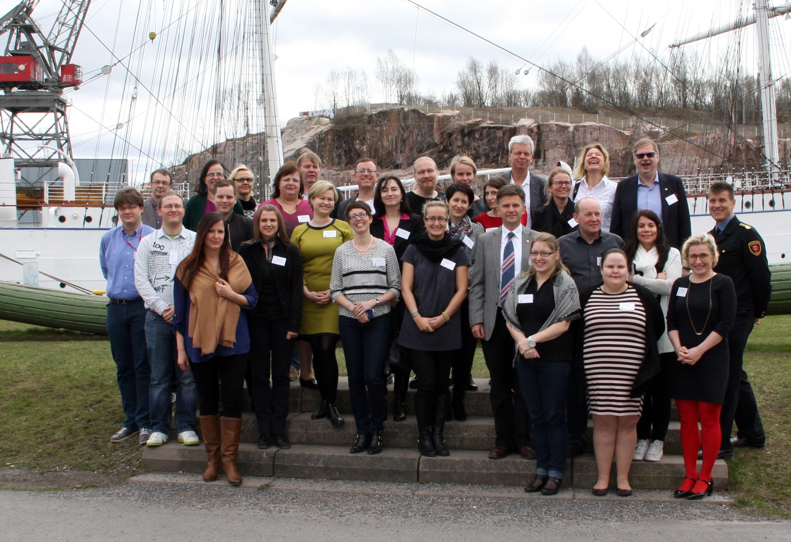
Meeting of UBC’s Communications Network during UBC Executive Board meeting 11 June 2015, Dolina Charlotty, Poland Irene Pendolin / Anna Kotaviita Communications Manager irene.pendolin@ubc.net / anna.kotaviita@ubc.net +358 40 848 6242

Slide 4
UBC Communications Network
Established in January 2015 – renewal process of UBC commissions.
37 cities’ communications representatives.
The new UBC commissions have been invited to select a person to be part of the UBC Communications Network in the role of the commission’s communications officer.
Only Safe Cities and Sustainable Cities Commissions have selected a communications officer to take part in the network.
All commissions are strongly encouraged to appoint their representative as soon as possible, in order for the communications and marketing within the UBC to function and also develop in the future.
It has also been suggested that UBC Executive Board will choose a Board member to monitor the implementing of UBC Communications Strategy and communicational issues.

Slide 5
UBC Communications Network
Main tasks of the commissions’ communications officers are to:
Ensure that the commission follows UBC guidelines regarding communications and marketing and that the commission’s contact details and other information are updated.
Act as a liaison in matters regarding UBC communications and marketing.
Main partners members of UBC’s Communications Network: UBC’s communications manager, other commissions’ communications officers and member cities’ communications experts.
Attend UBC’s training events in communications (seminars, workshops).

Slide 6
Outline of the seminar
Themes covered in the seminar included
UBC and its role in the Baltic Sea Region cooperation
HELCOM – a case example on developing external communications
Attracting the media
Social media as a tool for getting our messages known
Workshop on developing UBC’s external communications
Workshop on developing UBC’s internal communications
Seminar was live-streamed and videoed
Pre-seminar questionnaire
Feedback through online poll
Materials, videos and report of the seminar available at: http://www.ubc.net/documentation,55,3407.html (Documentation Centre → Seminars)

Slide 7
Feedback
Overall very positive
Useful, valuable and overall a very good seminar with participants from different commissions
Good beginning for developing UBC communications which can formulate into a tool that every member city can benefit from
Interesting to learn more about the UBC: Seminar clarified the new UBC commissions and their tasks, gave general information about internet, social media and media environment which can be useful for everyone in the future
Interesting lectures and discussions, everyone had the possibility to interact
Workshops helped to design new ideas about webpages and social media
Meeting interesting people and having a great time in Turku
“I had a lot of thought and knowledge to go home with and the seminar made me think more about my responsibility and the responsibility of each member city.”

Slide 8
Feedback
To be developed in future seminars
Workshops could have been divided for two days and arranged differently – the group was large to have discussions in.
Could have been more participants and more time. Member cities should have sent more people to the seminar who are directly working with the field (communications).
Participants were mixed, which can be a good thing, but then a lot of knowledge from the member cities in the particular field of the seminar is missed.
Instead of traditional workshops, online voting, live chats on the wall etc. could be explored, as well as using social media within the group.
Lectures were a bit long.

Slide 9
www.ubc.net – public website
Most important things to be developed in www.ubc.net
based on discussions and questionnaire answers
Creating a more functional and clear design, layout and platform, better structure and user-friendliness – webpage is like a business card of the organisation
Creating a more modern and attractive visual look
Website should be mobile-friendly
News, results of UBC work done in the commissions and cities as well as upcoming events should be more visible – less static information and more action on the pages
Giving out clear messages what UBC is and how and why cities should join UBC
Creating an intranet

Slide 10
www.ubc.net – public website
Website renewal would be preceded by renewal of UBC’s visual look, including logo.
Renewal of UBC’s visual look will also include the new commissions → Crucial not to invest in renewing commissions’ current websites, print mediums etc. until the general look of the UBC has been renewed. → Instructions will be provided by the UBC Secretariat/Comm. Manager.
The concrete work with ubc.net can begin immediately in June 2015, if funds for the work are allocated – preliminary negotiations with advertising agency KMG.
If starting the latest beginning of August 2015, a beta version of the website possibly ready for testing at UBC General Conference in October 2015
Opportunity to showcase UBC’s development, to int. and ext. audiences, including the media
Web and other communications renewal measures strongly support the Commissions’ renewal – they go hand in hand

Slide 11
UBC intranet – internal website
Intranet is seen as benefitting the work in both UBC commissions and member cities
Intranet through which internal communication within UBC should be carried out – accessible through the main UBC website (www.ubc.net)
Before intranet, main focus on designing and refining the contents of the main UBC website – keeping in mind and recording the requirements for the intranet, explore the possibilities of building intranet, for instance, from January 2016.
Continue developing, creating and re-organising UBC’s information management, finding solutions how to update information online and use more cloud services → explored in the Communications Experts’ session during UBC Board meeting in Dolina Charlotty

Slide 12
Baltic Cities Bulletin
The most important things to be developed
Updating the layout and format into a more modern form
Making the Bulletin more visual – better and larger photos and graphics
Distribution through electronic means
Bulletin should be better linked with www.ubc.net and social media channels
More space for commissions to present their current work
Considering distributing the Bulletin in the future mainly in digital format
Adding issue numbers in the covers
→ These questions should be discussed at the next Bulletin Editorial Board meeting, in the near future.

Slide 13
Social media
Results
Most used and most important tools in the member cities and commissions are digital ones.
Print mediums are used less and as an addition to the digital ones.
Social media as an important strategic communications medium that should be used more.
Developing digital communications is seen as important.
Focuse on
Developing content-sharing practices and overall communications in the social media together with the commissions and the member cities – creating synergy
Creating content according to UBC’s goals and target groups/stakeholders.
Visual and simple content – more pictures, videos and graphics, less text
More content about UBC’s own activities should be distributed. At the moment, most of the up-dates are member cities’ events.

Slide 14
Internal communication in the UBC
Results
UBC as an organisation and its achievements are well-known only to those who work directly with UBC issues
Local administration (including communications specialists) and politicians would need to be made more aware of their cities role in the UBC and take a more active role
Benefitting from the UBC work
Promoting UBC work in the cities.
To regular citizens, UBC work is unknown.
Internally, the commissions should be more informed about the work the other commissions are carrying out. There should be better and more frequent communication between the commissions → meeting once or more a year meeting to discuss dates, contents and events

Slide 15
Internal communication in the UBC
For the future, possible steps could be:
Boost campaigns in the member cities: spreading information about UBC work to colleagues and local politicians
Member cities acting as UBC ambassadors: seminar participants agreed they should take a more active role in their member cities to promote the work their city does in the organisation – “we need to do our homework first”
Member cities would like to cooperate in issues of international communications by sharing experiences and practices.
The cooperation between different commissions should be strengthened
Further training on internal and external communications could be organised in seminars and e.g. at UBC General Conference in Gdynia.
UBC Presidium and Board could encourage a stronger involvement of the cities’ politicians in the UBC activities, including exchange of experiences.

Slide 16
Internal communication in the UBC
Concrete changes in communications mediums that can help in developing internal cooperation
Internal communication within the network should be carried out through intranet that is accessible via the main ubc website.
Before the intranet, more efficient managing of contact lists and events would be especially important in order to avoid overlapping in UBC meetings and contacts. A meetings of commissions’ representatives and UBC Secretariat could be organised regularly (face-to-face and online) to discuss the work and events that will be carried out next year.
Emails should be more targeted and personalized and sent without word attachments.
Using more social media channels within the UBC.

Slide 17
Renewal process in communications and marketing
Measures, initial timeframe estimation and budget
Design of a logo and a visual ”face lift” / August
Design, production and testing of the web site www.ubc.net / June–November
Beta version of the website hopefully available for testing at UBC’s GC
Design, production and testing of UBC intranet / January–April
Creating UBC’s graphic guidelines and templates / January
Design and layout for the Baltic Cities Bulletin / January–February
Design of UBC general brochure / March–April
→ Altogether a maximum of approx. 20 000 euros which I propose will be allocated for this work.

Slide 18
Thank you!
Comments, questions, ideas? Please be in touch!
Irene Pendolin / Anna Kotaviita Communications Manager irene.pendolin@ubc.net / anna.kotaviita@ubc.net +358 40 848 6242

