Slide 1
PLANNING CITIES COMMISSlON
Action Plan and budget proposal 2015-2016
73RD MEETING OF THE EXECUTIVE BOARD
Dolina Charlotty, Poland, 11-12 June 2015

Slide 2
UBC Planning Cities Commission Seminars
The main subject of each seminar is proposed by the host city and always corresponds to the „hot problems” discussed in the city.
Usually the first part of the seminars involves academic inputs and presentations illustrating good examples and methods to work with the chosen subject in urban planning. Participants also participate in a guided bus tour and visit the site concerning the subject of the seminar .
The second part involves discussions and practical group work that would give input to the urban planning of the host city.
The host cities pays between 5.000 and 10.000 Euro when they hold a seminar.
Participants of the seminars pay their own travel and accommodation.
Each city hosting seminar had been supported by UBC with 5.000-6.000 Euro, so far .

Slide 3
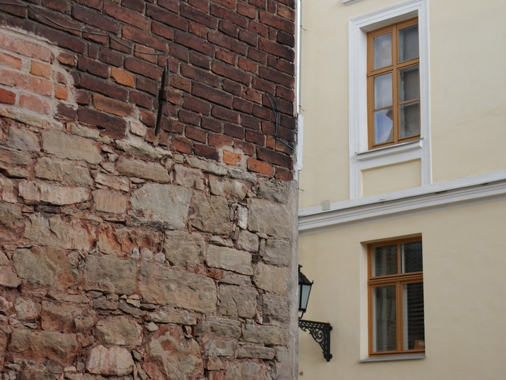
UBC JOINT COMMISSIONS ON URBAN PLANNING AND GENDER EQUALITY SEMINAR
“Building the Inclusive City ”
City Planning with Focus on Gender Equality and Children´s Perspective
UMEÅ, Sweden, 26-29 May 2013
UBC JOINT COMMISSIONS ON URBAN PLANNING AND CULTURE SEMINAR
“Cities in transformation. Creating potentials for City Life”
KOLDING, Denmark, 15-18 September 2013
UBC JOINT COMMISSIONS ON URBAN PLANNING, ENERGY AND TRANSPORT SEMINAR
“From a traffic corridor and wasteland to a lively city”
ÖREBRO, Sweden, 18-21 May 2014
UBC COMMISSION ON URBAN PLANNING
IN COOPERATION WITH ENVIRONMENT COMMISSION SEMINAR
“ Urban Streams”
RIGA, Latvia, 14-17 September 2014

Slide 4
Coming seminar
Gdańsk, Poland, October 2015
Söderhamn, Sweden, May 2016

Slide 5
UBC CITY PLANNING COMMISSION SEMINAR
“DEVELOPING SEA COST – LOCAL AND CITY-WIDE PERSPECTIVE”
GDAŃSK, POLAND, OCTOBER 18TH – 21TH 2015

Slide 7
Planning Cities Commission
Budget 2015 Euro
Steering Group meeting and seminar planning meeting in Gdansk, March 1 900
(Travels, accommodation and dinners, 4 persons, 2 nights)
Executive Board Meeting in Charlotta (1 person, one night + travel from Gdynia) 100
General Conference in Gdynia in October (1 person, travel + accommodation) 600
Steering group meeting and preparation of seminar in Söderhamn, December 3 000
(Travels, accommodation and dinners, 4 persons, 2 nights)
Communication officer (1 trip) 600
Chairman (1 trip) 600
Support to the city of Gdansk - seminar (20.000 PLN, accordingly to local budget) 5 000
2015 in total 11 800
Action Plan 2015
The commission will organize a seminar in Gdansk in October, and attend 3-4 UBC meetings inclusive the General Conference. At the seminar in Gdansk the new steering group and the Communication Officer will be elected/appointed. In December the preparing of the seminar in Söderhamn in the Spring 2016 will start. Hopefully we will manage to find a host city for the Autumn seminar.

Slide 8
Planning Cities Commission
Budget 2016 Euro
Steering Group meeting and seminar planning meetings 7 000
(Travels, accommodation and dinners (5 persons, 2 nights - 2 times)
Support to 2 host cities 12 000
Communications officer and chairman 2 400
(Travels, accommodation and dinners (2 nights - 4 times)
2016 in total 21 400
Action Plan 2016
The commission will organize a seminar in Söderhamn in the spring and another seminar somewhere in the Autumn.
Besides this the communication officer and the chairman (or another member of the steering group) will attend other UBC meeting building up the new structure.

Slide 9
We hope to be able to continue with two seminars per year
– if it’s possible with a raised support from UBC (from before 6.000
to 7.000 Euro for the seminar).
We look forward to have ”an election” for the Steering Group in October during the next seminar in Gdańsk.
We look forward to have a budget for travels to Steering Group meetings and preparation meeting also two times a year (due to less commissions).
We look forward to work together with the other six commissions, the Executive Board and the secretariat in Gdańsk in the new organization.

Slide 10
Thank you for Your attention
Members of the steering group:
Marek Karzynski, Gdynia
Mara Liepa-Zemesa, Riga
Tomas Stromberg, Umea
Niels-Peter Mohr, Aarhus - Chairman of the CUP

