Slide 1
Inclusive and Healthy Cities COMMISSION
UBC Board meeting
Charlotta June 2015

Slide 2
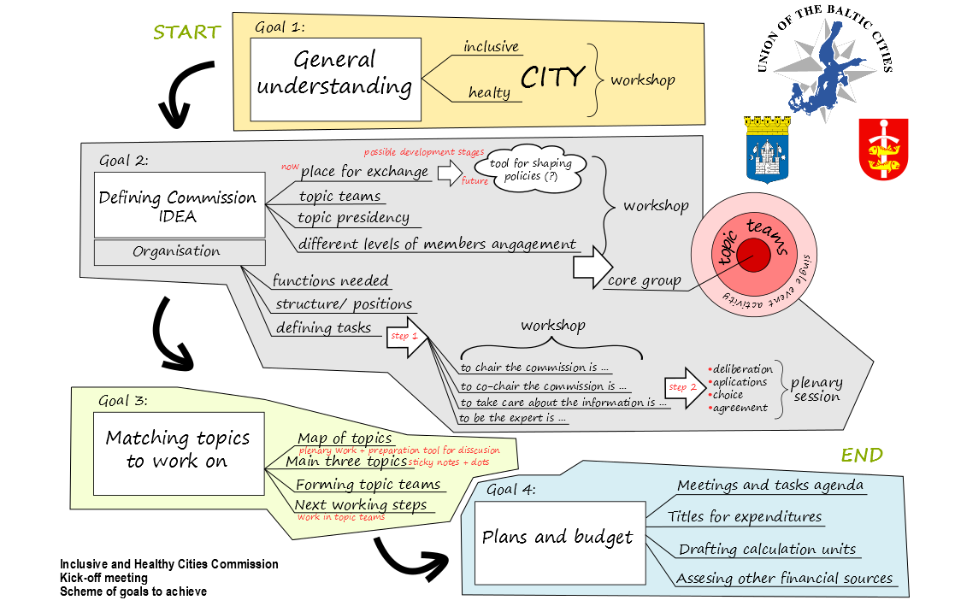

Slide 3
Open spaces idea
Phisical (third places)
Virtual (social media)
Functions – local social hubs
Horizontal (many target groups)
Participation, creative involvement
Equality
Inclusive and healthy factors
Dialog

Slide 4
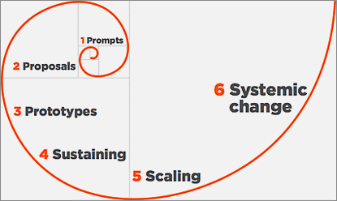
Recognition/ stages

Slide 5
Action Plan
3 meetings (2 meetings of the topic teams + 1 annual meeting),
Establishing communication channels,
Open spaces recognition (every City)
Matching the open space idea partners for exchange, single events, projects …
Defining financial sources for open space activities

Slide 6
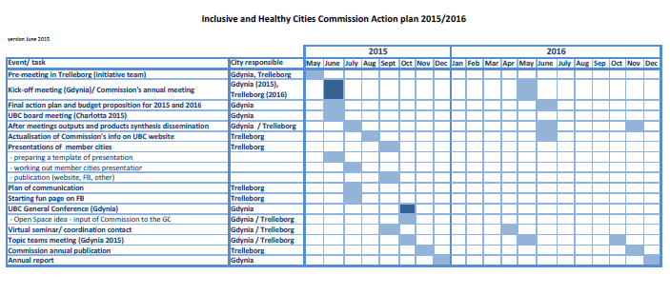

Slide 7
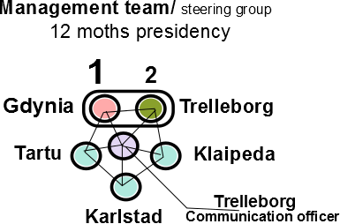

Slide 8
Budget
2015: 15 152 Euro
2016: 19 450 Euro

Slide 9
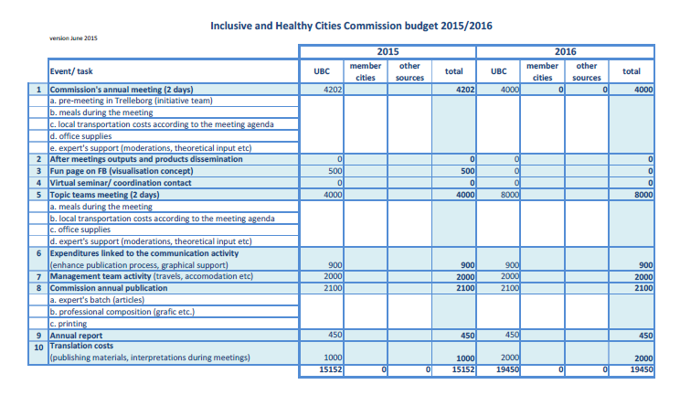

Slide 10
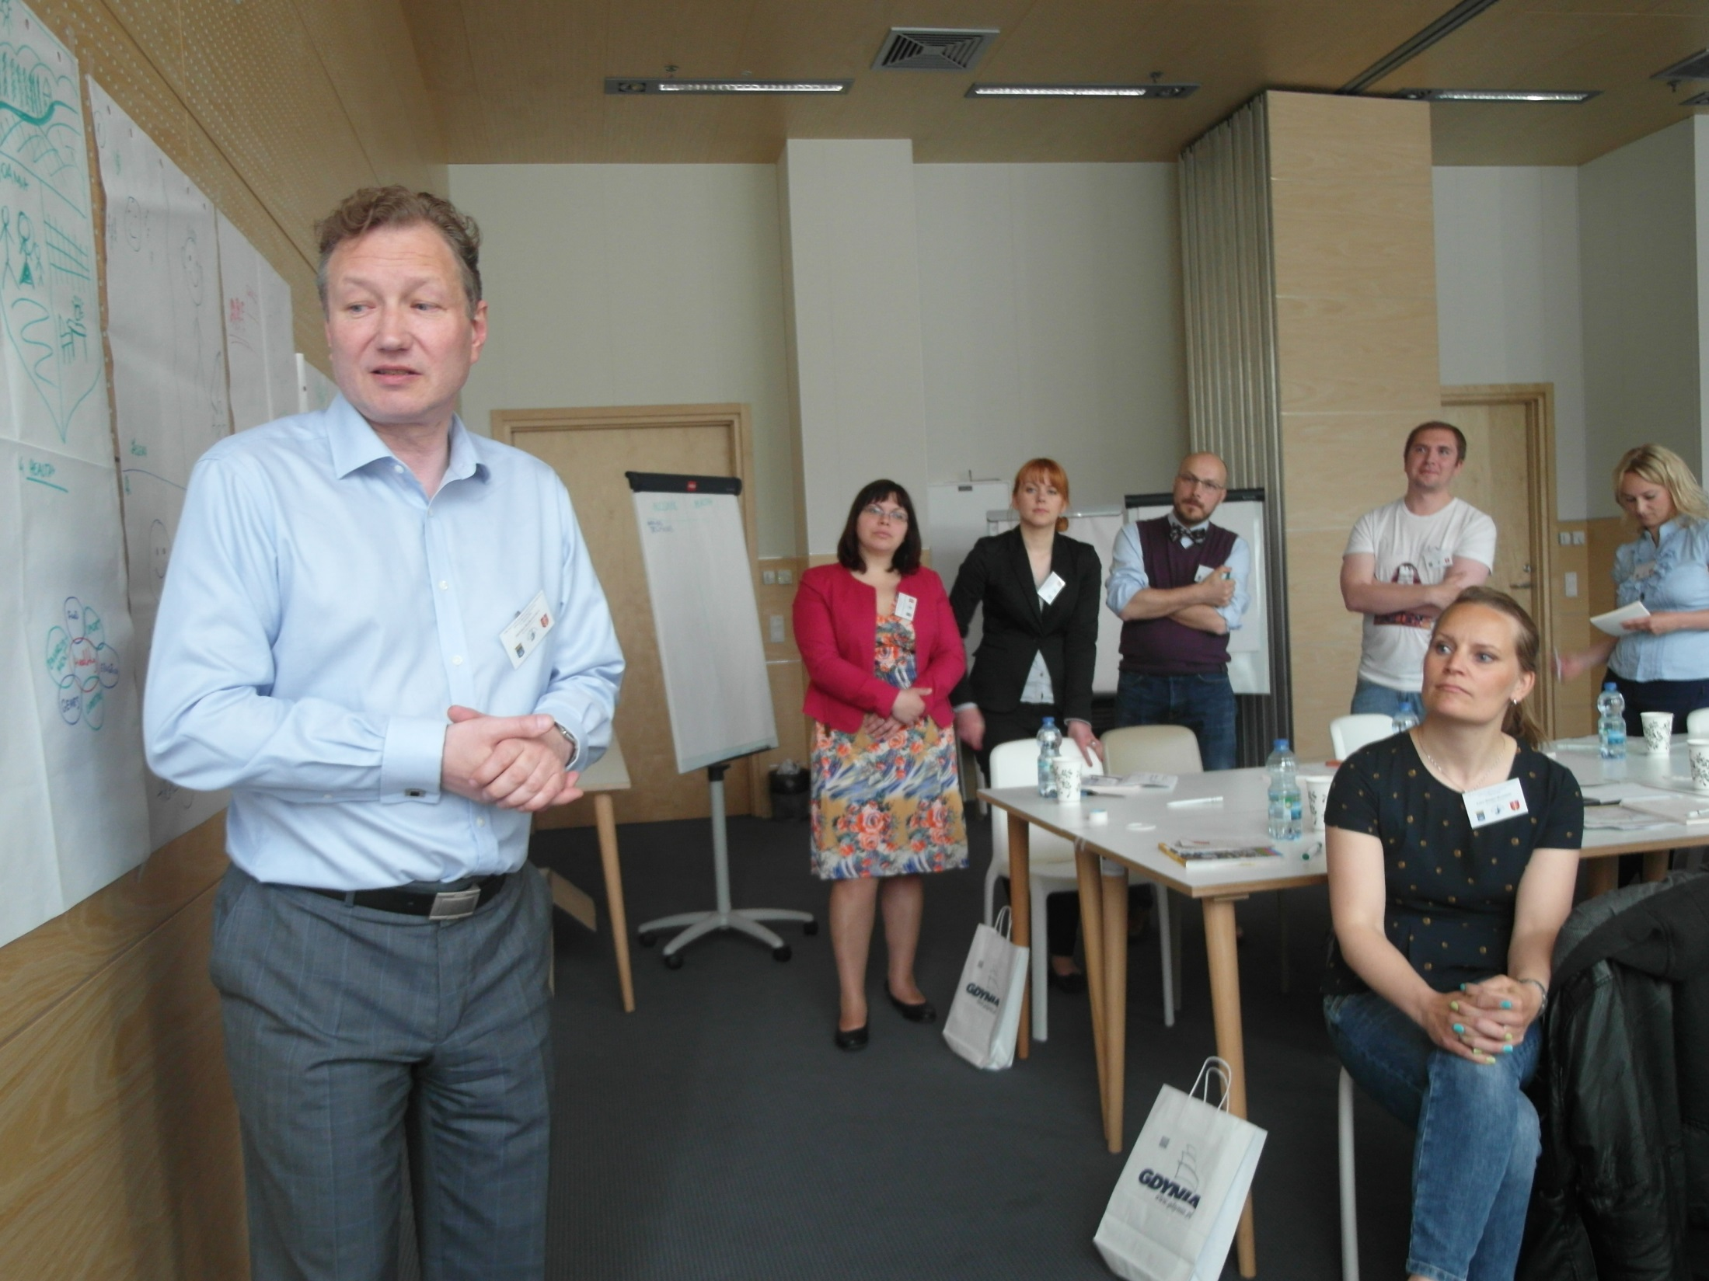

Slide 11
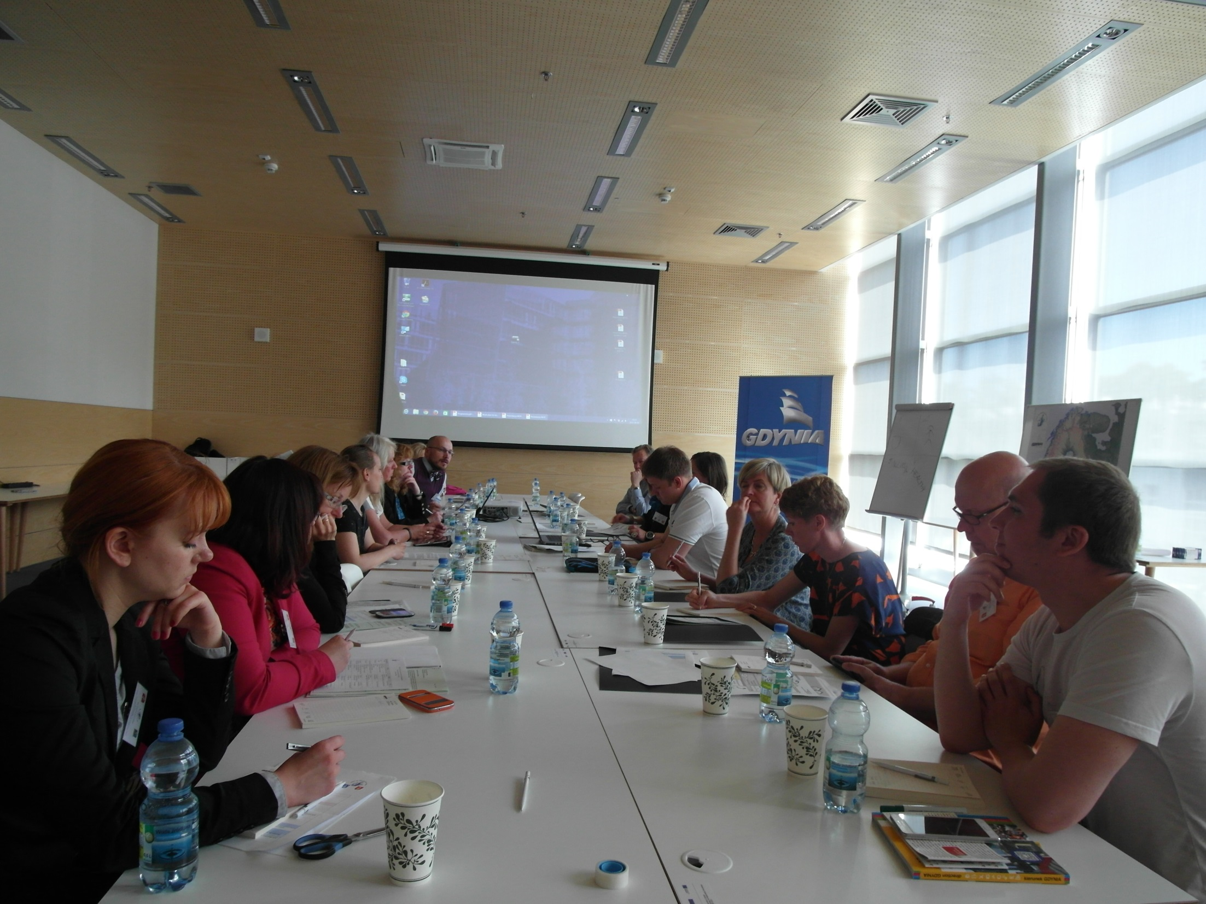

Slide 12
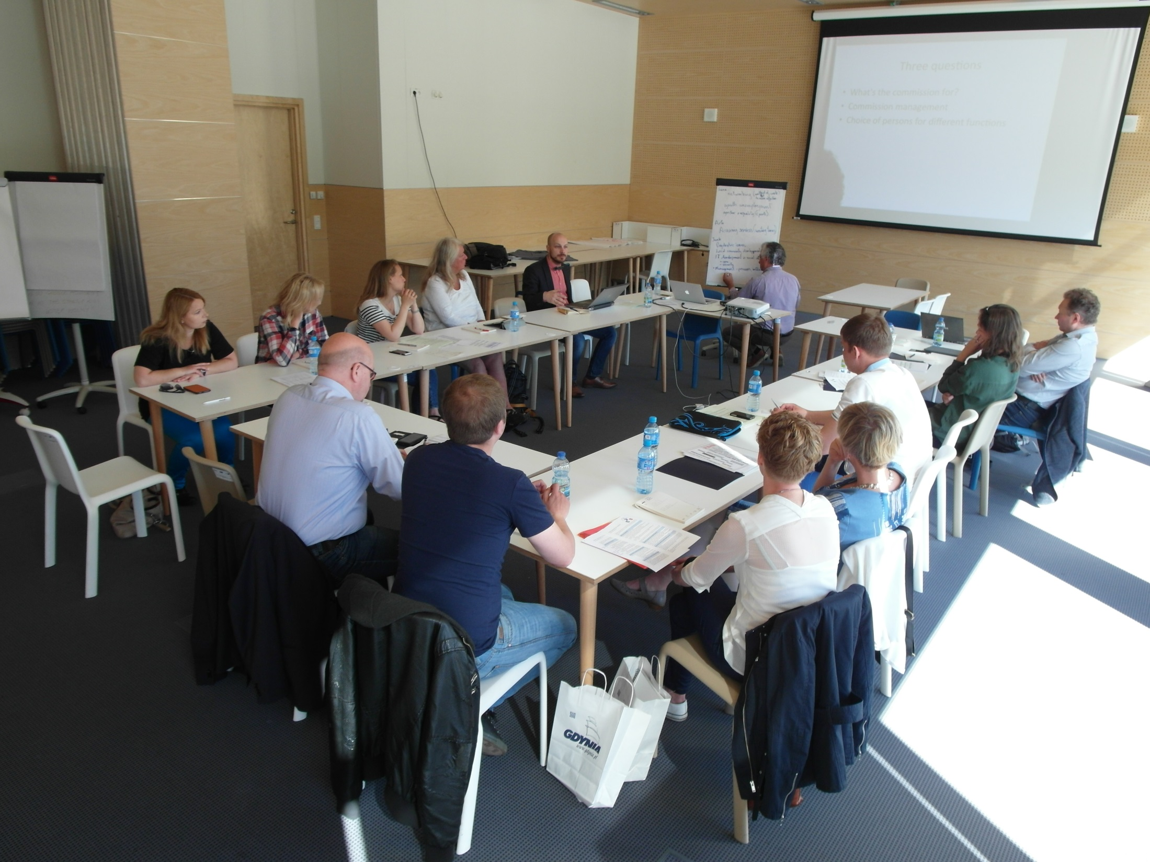

Slide 13
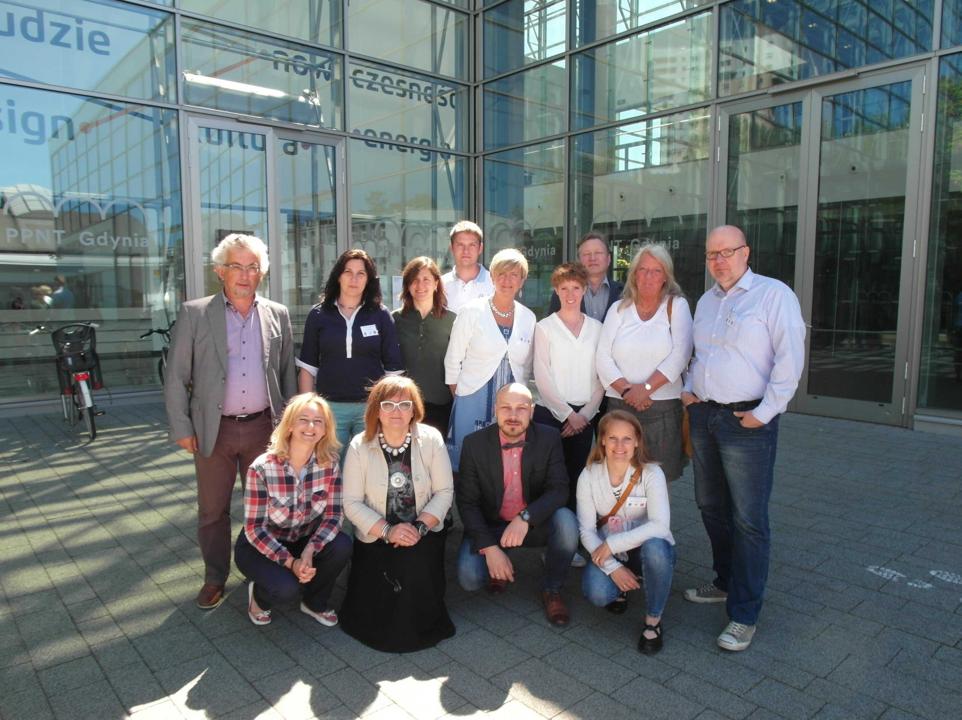

Slide 14
