Slide 1

Task Force on Youth Employment and Well-Being
Matti Mäkelä, Chair
Head of the Project Management Office
City of Turku / Education Division

Slide 2
Task Force Report 2014
PART I: General overview
PART II: Where are we now? Where will we be tomorrow?
PART III: Where the magic happens
PART IV: Calculations and savings

Slide 3
Meeting and Participants
Task Force held three meetings in 2014 (Tampere, Turku and Karlskrona). First meeting of the year 2015 was held in Riga in January.
Task Force used OpenDrive in joint work efforts.
So far, 22 experts representing 14 UBC cities have contributed to the work of the Task Force

Slide 4
TOP 7 questions
1) How to motivate youngsters? Tools and methods
2) How to promote social enterpreneurship and social economics?
3) How to recognize and validate skills of the youngsters?
4) New ways for guidance and support of Immigrant-youngsters that arrived in their teens
5) How we can use new technology more efficiently in guidance, support and education?
6) Steps from ill-being to well-being and employment
7) How we help the system to become more diversity-friendly?

Slide 5
Workplan for the year 2015
February 18th: DL for the TOP 7 solutions + contact information (onedrive) + explanations for each question
February 26th and 27th: Board meeting in Kemi
February – March: Check for possible ESF funding to continue and deepen the cooperation between TF partners
March 6th: Report and other materials will be loaded in www.koulutustakuu.fi/training-guarantee

Slide 6
Workplan for the year 2015
April 8th at 2 pm (Finnish time): online meeting for TF partners
March - May: local workshops and short reports about the results
June 2nd and 3rd: meeting in Denmark, Naestved
September: Follow-up report from each partner
October: final seminar (?) and presentation of the results of the Task Force

Slide 7
Proposals and initiatives
Final seminar (is it possible to arrange as a part of Gdynia conference?, funding?, keynote speakers?)
Future cooperation
Funding in future (a common project)
What kind of role does the UBC Board will have when it comes to implementation and mainstreaming the good practises, model and proposals done by Task force

Slide 8

Example of the Solutions:
Youth Guarantee Vision and Implementation Plan for the Turku Region

Slide 9
About the Vision and the Implementation Plan
The Youth Guarantee NOW project was implemented in Turku region in Southwestern Finland last year. Its aim was to create a new, more concrete Youth Guarantee vision for the region along with a supporting action and implementation plan. The contents of the vision as well as the action and implementation plan were based on surveys, seminars, workshops and expert interviews.

Slide 10
About the Vision and the Implementation Plan
The actions are divided into the following four groups:
Continued operations - If It Ain't Broke, Don't Fix It
Activities in need of development - Business as Usual
Radical innovations - To Boldly Go Where No Man Has Gone Before
Catch 22 - Don't Try This at Home

Slide 11
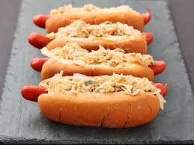
If It Ain’t Broke, Don’t Fix It

Slide 12

Business as usual

Slide 13

To Boldly Go Where No Man Has Gone Before

Slide 14
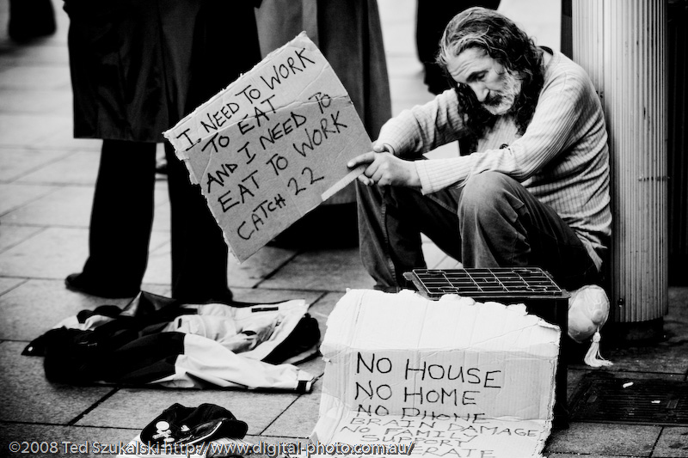
Catch 22 ‒ Don’t try this at home

Slide 15

www.koulutustakuu.fi/training-guarantee

