Slide 1
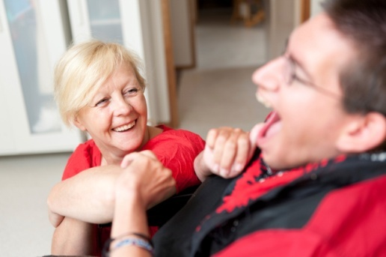
Developing Community Care
Lisa Schönenberg
Jukka Lindberg
European Social Network
UBC meeting, Tartu, 30 May 2013

Slide 2
About ESN
Who we are
The independent non profit network for managers of public social services, health, education and employment in Europe.
The network has over 90 Member organizations in 30 countries,
including professional associations of directors of public social services, national, regional and local public authorities, development, research and quality monitoring agencies.

Slide 3
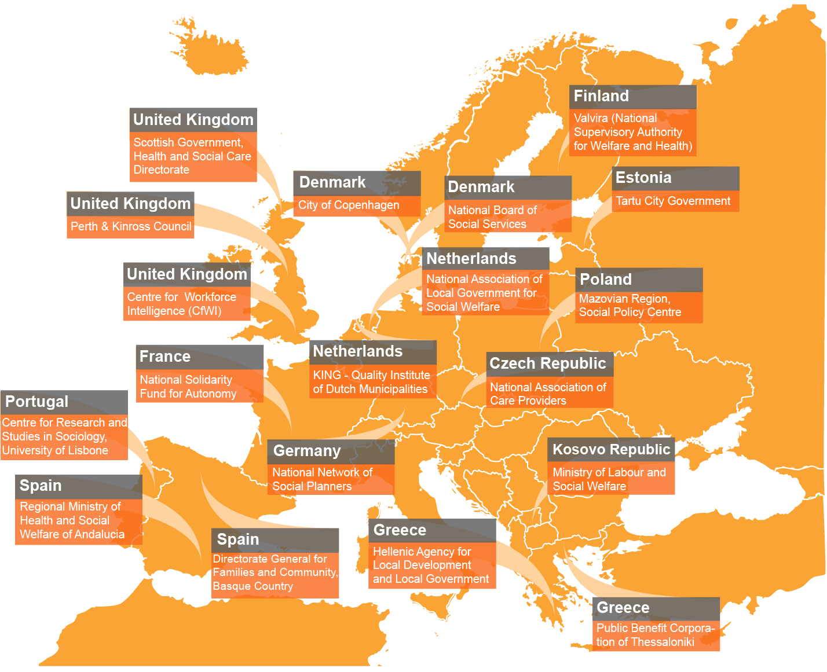
Last year we welcomed 19 new Members.

Slide 4
About ESN
What we do
>> We facilitate good practice exchange.
>> We bridge the gap between European policy-making and local practice-based experience.
>> We deliver policy knowledge to Members and other stakeholders.
>> We advocate the empowerment of service users, joint working across service boundaries and quality assurance.

Slide 5
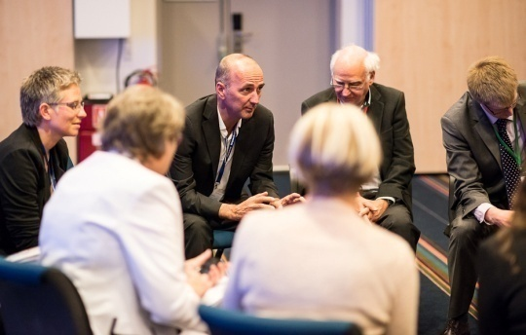
Managing Social Services
ESN Working Group
Leadership, Performance and Innovation Working Group
>> Launched early 2012, consists of 9 senior managers in social services from across Europe.
>> Themes
The impact of the crisis and responses to it
Leadership and management in social services
Performance management and evidence-based practice
Innovation in social services, including social innovation

Slide 6
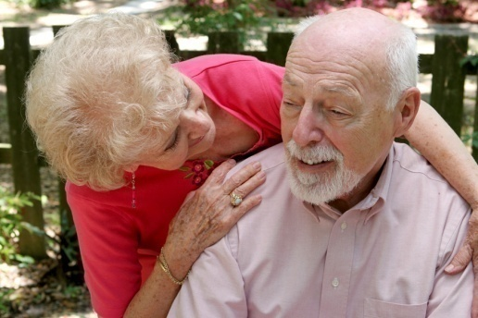
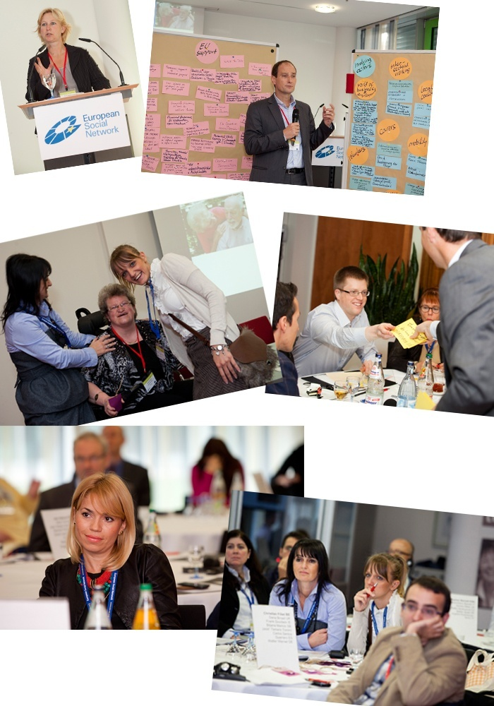
Long-term Care for Older People ESN Autumn Seminar 2012
STUTTGART, 24-25 OCTOBER Independence and Inclusion in Later Life
>> European Year for Active Ageing and Solidarity between the Generations 2012
>> How to shift the focus of services to prevention of care need and rehabilitation to independence/self-sufficiency in old age?
>>Practice examples: Fredericia (DK), Institute for Social Security (PT)

Slide 7
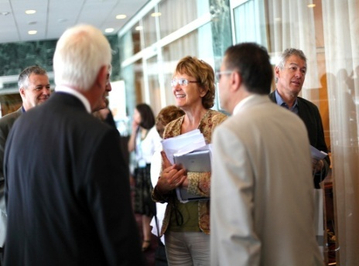
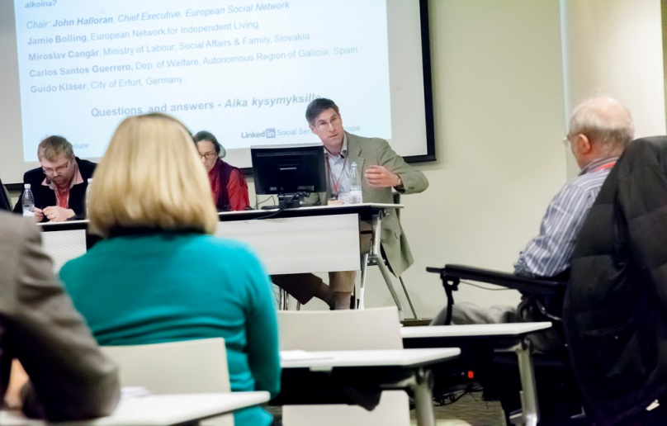
People with Disabilities
ESN Spring Seminar 2013
HELSINKI, 18-19 APRIL 2013
“[…] you can choose who you want to live with and who helps you.”
(service user, 39, Germany)
>>How social services can make choice and control happen in practice? Personal Assistance, Personal Budgets
>>Involvement of service users in the design of services and needs assessment
>> Practice examples: PA Vienna, AT

Slide 8
European Social Services
Conference
DUBLIN, 17-19 JUNE 2013 ‘Transforming Lives! Reshaping services for a changing society’
>> In cooperation with the Irish Presidency of the European Union
4 plenary sessions on reshaping services, building partnerships, improving outcomes, social investment
>> Key speakers: Ireland’s President Michael D. Higgins
Joan Burton, Minister for Social Protection, Ireland, Michael Marmot, Director, WHO Europe Alain Régnier Interministerial Delegate for Access to Housing, France
24 workshops on children & families , workforce and management, young people, health care, impact of the crisis, older people, technology, community care, quality and performance, employment, inter-service cooperation
http://www.esn-conference.org/

Slide 9
“[…] see, I want my own key and my own front door”
(Service user, 34, Latvia)
Notes:
So what has ESN done in this area?

Slide 10
Developing Community Care
Europe’s hidden population
>> A hidden population living in long-stay institutions:
1.2 million persons with disabilities
300 000 persons with mental health problems
150 000 children
>> While an institutional setting may provide physical security (food, shelter), it also fosters dependency, over-protection and exclusion of service users and cannot offer the sense of well-being that stems from being included in society.
Notes:
Most people take living in and being a part of the community for granted. And yet in Europe this is not the case for a large portion of Europe’s most vulnerable population, many of whom live in large residential institutions, segregated from the rest of the world and from their local community.
It is not clear how many people live in institutions in Europe, as there is often very little reliable data available. However, estimates show that there are likely to be in the millions.
1.2 million persons with disabilities
300 000 persons with mental health problems
150 000 children
…living in long-stay institutions across the continent.
These people are in effect hidden population. Alongside challenges such as demographic ageing, migration, discrimination, unemployment or child poverty, the transition from an institutional to a community-based model of care remains one of the major challenges facing the European Social Model.
While an institutional setting may provide physical security (food, shelter), it also fosters dependency, over-protection and exclusion of service users and cannot offer the sense of well-being that stems from being included in society.
Although many policy papers have underlined that care at home is preferable to care provided in long-stay institutions, very few countries have increased public spending on developing integrated community care or on greater coordination btw health and social care. Most EU countries, with the exception of Denmark, spend the majority of their long-term care budgets on building, renovating institutions.
Despite the evidence supporting the normalisation of people with complex health and social needs, there are still those who believe that the well-embedded institutional model of care is simply too difficult to change. Sceptics argue that the transition is too complex and expensive to manage and that services in the community are unaffordable.
However, there have been some promising attempts to overcome these barriers to change, as I will show later on.

Slide 11
Developing Community Care
Definition of Institutional Care & Culture
>> Institution: a long-stay residence in which people live and receive care for an unspecified period of time following a medical or social assessment or a court decision.
>>Report by European Ad Hoc Expert Group talk of ‘institutional culture’:
depersonalisation
rigid routines
no individuality of treatment
social distance and isolation
>> It is not just about size!
Notes:
Let’s start by defining what an institution is. ‘Institution’ refers to a long-stay residence in which people live and receive care for an unspecified period of time following a medical or social assessment or a court decision deciding about their care.
The European Ad Hoc Expert group (which is the group of international experts) has described certain characteristics which exemplify institutional culture:
The group argues that external features (such as walls, gates, large secluded buildings) are merely ‘the most visible and not necessarily the most important in defining what is an institution’.
Instead they propose to concentrate on such internal characteristics, defined as: “1) depersonalisation (not having the names on the doors of their rooms); 2) rigidity of routine (fixed timetables for waking up, eating and activity irrespective of personal preferences or needs); 3) block treatment (processing people in groups without privacy or individuality) and 4) social distance and isolation (symbolised in the actual distance between residents and the rest of the community).”
NOTE: It is important to remember that these characteristics can occur in settings of different sizes. Deinstitutionalisation , that is the transition from institutional to community-based care is not just about closing hospital or large residential services – but the need to develop high quality services in the community.

Slide 12
Developing Community Care
Community-based services
>> Assistance, support and care in the community
>> Choice and control: where, with whom and how they live.
>> ‘Vulnerable’ people should live alongside ‘ordinary’ people
>> Develop community-based services which provide support:
Mainstream services: housing, healthcare, education, employment, leisure
Specialised services: personal assistance or special day-care centres
Notes:
In contrast…
Community-based services are forms of assistance, support and care in the community that enable people to overcome or manage whatever condition, disability or set of life circumstances they face.
‘Community based’ refers to the idea that vulnerable people should live alongside ‘ordinary’ people in the same street, rather than be segregated from them. Furthermore, ‘community-based services’ tend to be seen as the best setting in which to empower the user to participate in society and to take control of his/her own life.
It is about providing users with choice and control: Enabling them, to the greatest extent possible, to choose where, with whom and how they live. Providing whatever help with their care needs to enable them to participate successfully in the community. This involves developing community-based services and resources that vulnerable people need to live a normal life in the community.
This includes the development of mainstream services, such as housing, healthcare, education, employment, culture and leisure, which is accessible to everyone who needs it. It also refers to specialised services, such as personal assistance for people with disabilities or special day-care centres for children with disabilities. Having these specialised services helps prevent isolation within the community and promotes social inclusion.

Slide 13
ESN at work
‘Managing Change’ in the Visegrád Countries
Training programme for Czech Rep, Hungary, Poland, Slovakia
16 policy makers & social managers
Aim: to develop principles, values and skills for managing the change from institutional to community-based care
Taught sessions; group discussion; service visits
Some concrete achievements
Notes:
Managing Change training group for 16 social managers and policymakers from the Visegrád countries, that is CZ, HU, PL, SK….
…With 4 participants were selected from each country.
The aim of the training programme was to provide participants with expertise on how to manage the transition process in their countries by providing them with the principles, values and skills necessary to develop modern community-based services and to support the closure of institutional care services in their respective countries.
The training included taught modules, discussions and group work as well as study visits to local services (Brighton, Prague and London). Also brought in service users…
It also allowed each country group to present their country’s strategy for closing institutions and developing community care – they were asked to analyse the strengths, weaknesses, opportunities and threats to their plans.
Key achievements of the training:
Slovakia: Currently developing a national platform for activists promoting deinstitutionalisation at grassroots level
Mazovia region: Are looking to include deinstitutionalisation as a priority area for their regional strategy 2014-2020

Slide 14
European Expert Group on Transition
from Institutional to Community Care
>> Common Guidelines for Transition to Community Care for European Member States
>> Toolkit on the use of European Funds for the Transition to Community Care
>> Training for national officials from Ministry and public authorities in 2013 from across Europe
>> See on ESN’s website: http://www.esn-eu.org/publications-and-statements/index.htm
Notes:
REWRITE
EEG group
ESN is a member of the European Expert Group, coalition gathering of stakeholders who promote the transition from institutional to community care on European level.
TWO DOCUMENTS:
Guidelines for key players Member States on transition process. It is not a step-by step guide, but focuses on the key elements of deinstitutionalisation and the outcome that should be achieved.
Toolkit on use of Structural Funds. Is based on draft regulation for the next budget period 2014-2020.
Training is coming

Slide 15
Developing Community Care
The way forward
>> There are a growing number of opportunities to bring about change:
European structural funds – a new emphasis on community-based services
Guidelines and ‘Toolkit’ from European Expert Group
UN Convention on the Rights of Persons with Disabilities
New national and regional DI strategies
Sharing best practice
Notes:
RETHINK SLIDE The transition from institutional to community-based care is desirable and – despite, difficulties – achievable if we all play our part
in this process.
There are some instruments which present key opportunities for change….

Slide 16
Thank you!
www.esn-eu.org
Lisa.Schoenenberg@esn-eu.org
European Social Network
Tel: +44 (0) 1273 739039 | Fax: +44 (0) 1273 739239
Victoria House, 125 Queens Road, Brighton BN1 3WB, United Kingdom

Slide 17
Developing Community Care
Case studies
Deinstitutionalisation for people with mental health problems, Italy
Child care reform, Georgia
Mental health care reform, England
Community Care for All, Moldova
Leading the staff, Sweden
Closure of Institutions Hrastovec and Trate, Slovenia
Vyšší Hrádek, Czech Republic
Notes:
There have been various good practice examples/case studies from across Europe which show that deinstitutionalisation is not only necessary but possible.
In each case the process of deinstitutionalisation was quite different. Some are were led by government reform, some by user organisations, others by the staff and management in institutions.

Slide 18
Making the case
European Funding I
>> Structural Funds for 2014-2020
Ex ante conditionalities:
Thematic – strategy for a shift from residential to community care
General – mechanism to ensure effective implementation of UN CRPD
Further regulations:
SF may not be used for actions contributing to any form of segregation and discrimination
Investment priority: Promote social inclusion and fight poverty
Explicit reference to transition from institutional to community care
Notes:
It is worth noting that the draft proposals for ESF and ERDF regulations covering the period 2014–2020 specifically mention the transition to community care as eligible for funding. It remains to be seen how many EU Member States will include this opportunity in their operational programmes, to be agreed with the European Commission. It seems, however, that the ratification of the UN Convention on the Rights of People with Disabilities by the EU, in particular its article 19 (the right to live in the community) has helped to place the transition to community care firmly on the agenda.

Slide 19
Making the case
International Human Rights
>> UN Convention on the Rights of Children
Article 23 recognises “that a mentally or physically disabled child should enjoy a full and decent life, in conditions which ensure dignity, promote self-reliance and facilitate the child's active participation in the community.”
>> UN Guidelines for the Alternative Care of Children Guideline 22: “...where large residential care facilities (institutions) remain, alternatives should be developed...”
>> UN Convention on the Rights of People with Disabilities
Article 19: “Persons with disabilities have the opportunity to choose their place of residence and where and with whom they live on an equal basis with others and are not obliged to live in a particular living arrangement.”
>> UN Principles for Older Persons
Principle 5: “Older persons should be able to live in environments that are safe and adaptable to personal preferences and changing capacities.”
Notes:
Just like the voice of former residents and the values of social work, international treaties and conventions clearly favour community-based over institutional care. The wide array of international, European and national legal acts and declarations aim to prevent segregation, guarantee equal opportunities and safeguard the human rights of the most vulnerable people. They emphasise that every person, whether young or old, whatever disability or illness they may have, should enjoy the same rights and responsibilities: these are not negotiable and cannot be restricted or removed due to arbitrary criteria.

