Slide 1
Citizens for Safety
seed money application

Slide 2
Instrument
Seed money is an EU grant scheme to prepare projects helping implement one of the priority areas or horizontal actions of the EU Strategy for the Baltic Sea Region.

Slide 3
Project identification
name: Building urban safety through citizens participation
acronym: Citizens for Safety

Slide 4
Relation to the EU Strategy
Priority Area: Secure
Protection from emergencies and accidents on land
Action: Enhance a joint urban safety and prevention approach in the Baltic Sea Region
Coordinator: Sweden and the Council of the Baltic Sea States (CBSS) Secretariat

Slide 5
Partners
Gdansk Municipal Guard (lead partner)
Riga Municipality Police
Vilnius City Municipality
Liepaja Municipal Police

Slide 6
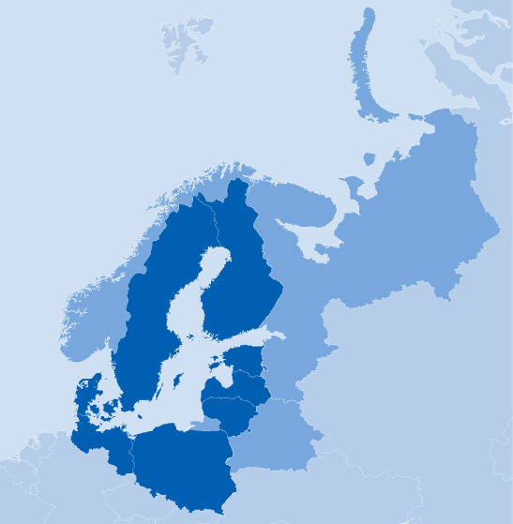
Issue addressed
Commission on Local Safety (CoLS) has been assigned in the Action Plan for the EU Strategy for the Baltic Sea Region to lead the flagship project: Effective learning and exchanging best practices on urban safety through a local city network.

Slide 7
Issue addressed
In EU 2020 Strategy there is the Flagship Initiative: A Digital Agenda for Europe, directed at promoting „deployment and usage of modern accessible online services (e.g. e-government, online health, smart home, digital skills, security)”.

Slide 8
Project outputs
state of play in the field addressed by the project including an overview of complementary projects

Slide 9
Outputs
Establishing cooperation between all stakeholders on local level.
Collecting data related to feeling of security from project partners and organizations dealing with safety.
Preparing one-for-all questionnaire for the survey. Meeting in Gdansk.

Slide 10
Outputs
Conducting web based survey to identify safety and security threats in the local environment.

Slide 11
Outputs
An analysis of the survey and a publication of the findings.

Slide 12
Outputs
Providing an overview of complementary projects.

Slide 13
Project meetings
Gdansk & Liepaja

Slide 14
Meeting in Gdansk
Theme: Introducing main stage project and getting the publicity.
Duration: 2 days.
Participants: 2 employees per partner + 10 external.
DTBD

Slide 15
Meeting in Liepaja
Theme: We care for safety.
Duration: 2 days.
Participants: 2 employees per partner + 10 external.
DTBD

Slide 16
Funding for the main project
one potential source & more to be found…

Slide 17
ISEC
Prevention of and Fight against Crime Programme
ISEC has a budget of EUR 600 million for the period 2007–13 and contributes to citizens’ security through projects that prevent and combat crime.

Slide 18
Total project budget
EUR 47,698

Slide 19
EU grant
85% of total

Slide 20
THANK YOU for your attention.

