Slide 1
Southwest Finland Emergency Services

Slide 2
Rescue service regions in Finland
Municipalities have a statutory duty to organise rescue services together in rescue service regions

Slide 3
Varsinais-Suomi in figures (2012)

Slide 4
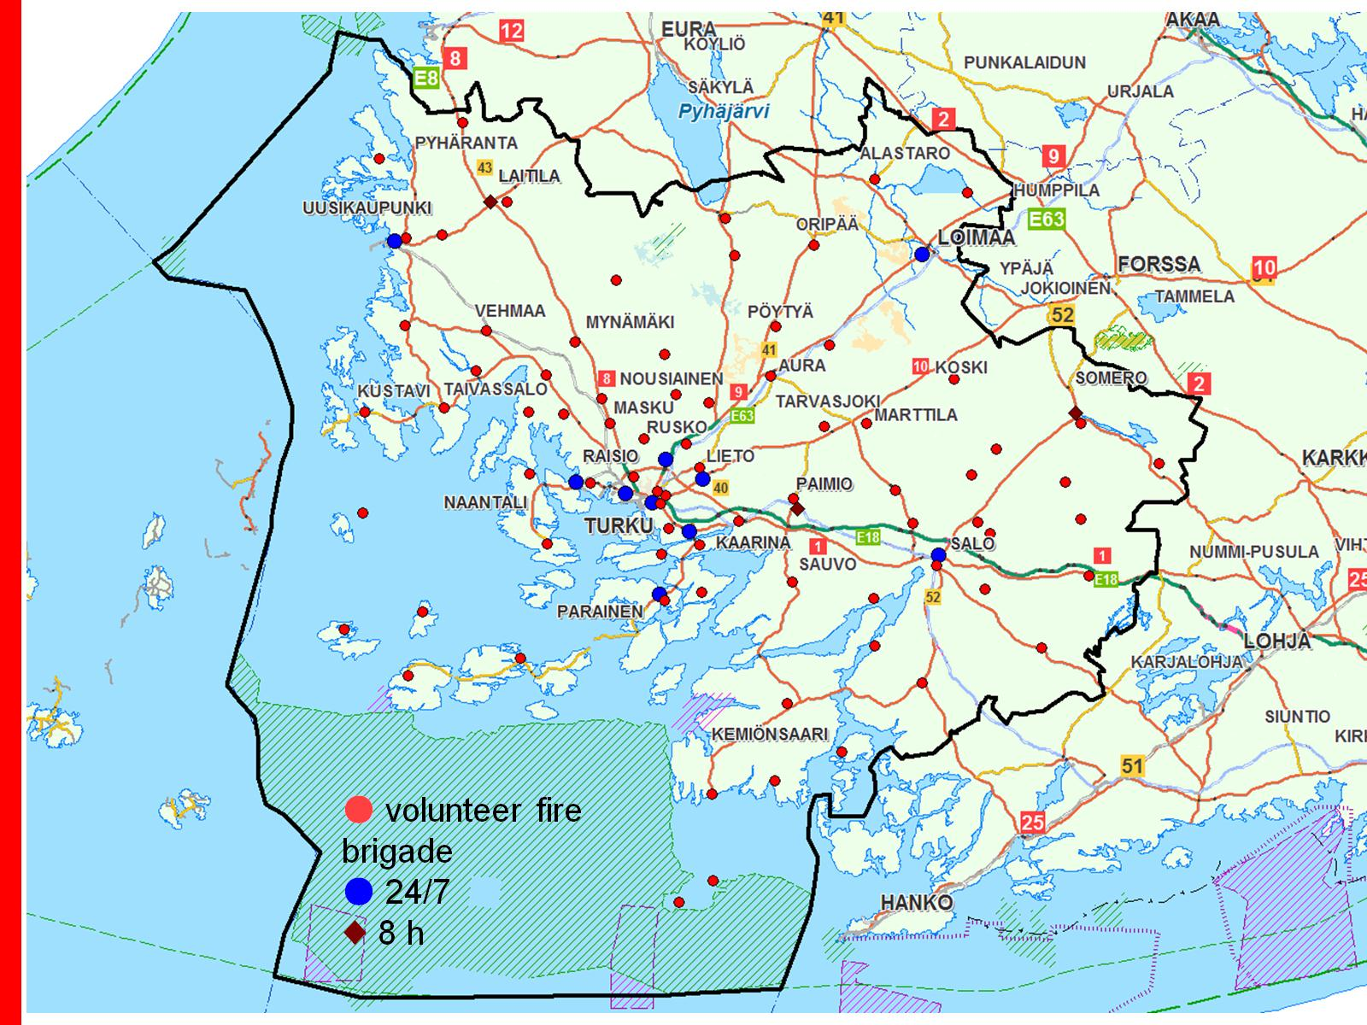

Slide 6
Organisation

Slide 7
The rescue department in figures

Slide 8
Finances 2012

Slide 9
Cost structure of the rescue operations

Slide 10
Rescue operations 2012

Slide 11
Fire stations in Varsinais-Suomi

Slide 12
Main principles of the operating model

Slide 13
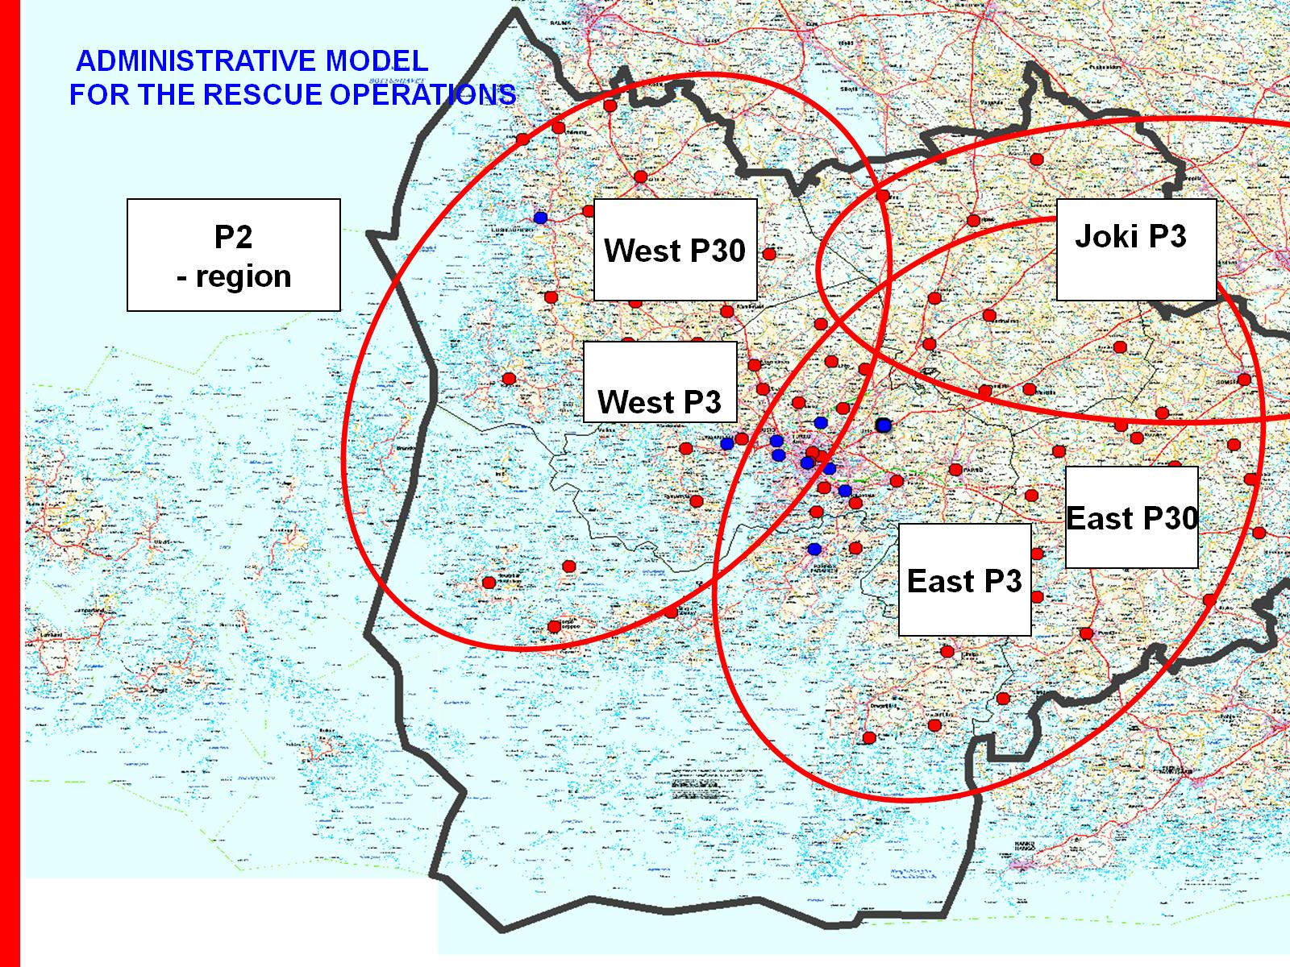

Slide 14
Operating areas of the on-call personnel

Slide 15
Vehicle fleet

Slide 16
The many tasks of rescue services

Slide 17
Operative rescue missions in 2012

Slide 18
Operative rescue missions in 2012

Slide 19
Fire fatalities in Varsinais-Suomi

Slide 20
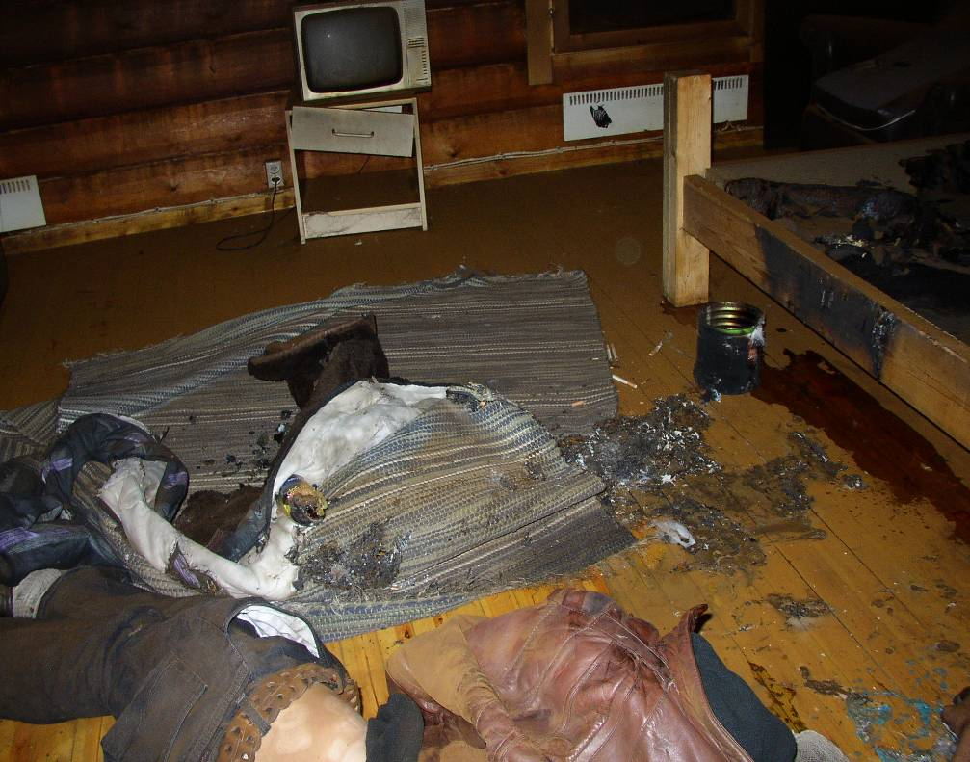
Fire investigation
In the past, only the Police did fire investigation in Finland
Year 2005, project started, all fire deaths (fatalities) investigated and analyzed by the rescue services
2007 -2008 Project continued. Fire deaths and serious injured in fire are investigated together by the police and rescue services
2009 => permanent
2011 New rescue law, rescue services has to do fire investigation

Slide 21
When
Fatalities (fire deaths) and serious injured in fire
hospitals and care centres
block of flats, smoke in the staircase
facilities under ground, like tunnels, parking

Slide 22
Co-operation

Slide 23
Co-operation, instant benefits
Is this a crime? accident perhaps?
Benefits:
Fire fighters know to be careful when they put out the fire
More eyes
Even if not a crime, police is helping the rescue service
And much more

Slide 24
Co-operation

Slide 25
Co-operation, long time benefits
Better statistic for analyses
Knowledge of fire courses > better riskmanagemet
And much more

Slide 27
Cost structure of the emergency care services

Slide 28
Rescue department's emergency care services − tiered field organisation

Slide 29
Fire inspections conducted 2008–2012

Slide 30
Training and communication services

Slide 31
Safety communications

Slide 32
Figures related to safety communications 2012

Slide 33
Personnel training 2012

Slide 34
Training for contract fire brigades 2012

Slide 35
Thank you!

