Slide 1
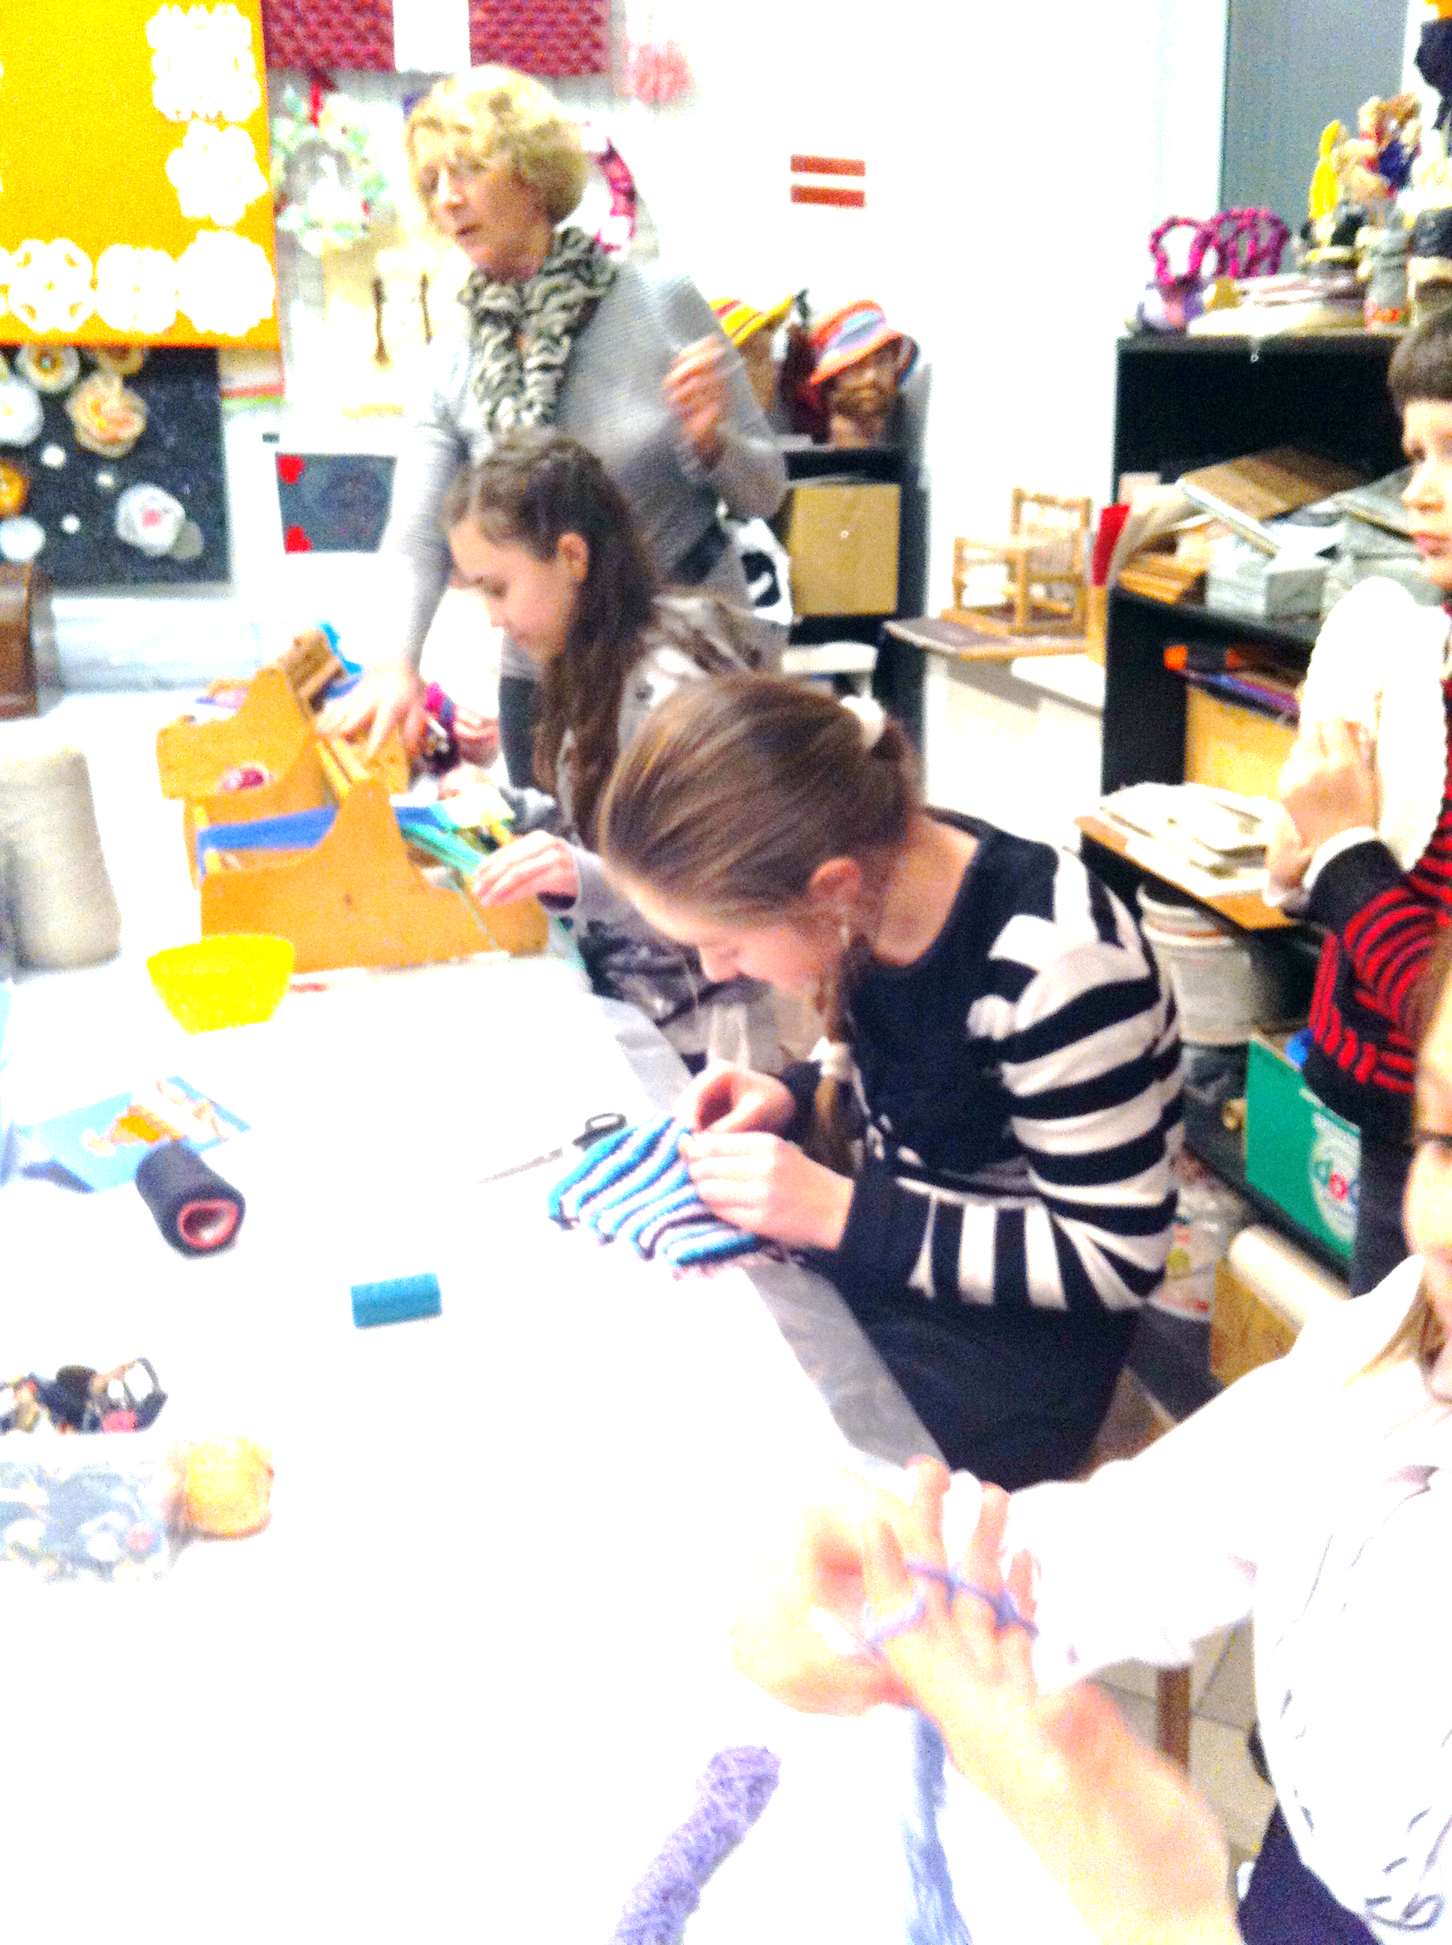
UBC Commission on Culture
Chairperson Lone Leth Larsen

Slide 2
Committee on Culture so far
Organization of the committee
Difficult start up - hired an assistent
Board meetings mostly on Skype
Board meetings ends with an open seminar with a relevant topic e.g. ”Social and cultural inclusion – culture as a tool for social inclusion” (Gdansk) using volunteers in Culture (Kolding) Ensuring sustainability in old touristic towncentres (Tallin)

Slide 3
The new vision for CoC
A network based cultural cooperation
Professionalization of the cultural field
Strategic partnerships
Research

Slide 4
The strategy for CoC
1.) Network based cultural cooperation:
To develop the exchange program even further, as this program has 3 aims, namely to stimulate professionalization, to create, and develop the UBC cultural network, and to stimulate project making between the UBC cities
To promote a more intensive cooperation between the UBC cities on cultural level, both by a small fund and by the cultural prize, which has as criteria the cooperation aspect
To promote the cities to invite cultural project from the other UBC cities for local events like festivals, celebrations or part of the daily programs

Slide 5
The strategy for CoC
2.) Professionalization of the cultural field:
The exchange program
Sharing experiences at meetings and conferences
Sharing new knowledge in newsletters, facebook and the like

Slide 6
The strategy for CoC
3.) Strategic partnerships. Partners we want to develop contact to in order to promote the interests of the local level
Nordic council
Pack and the European Union,
Ars Baltica
Others

Slide 7
The strategy for CoC
4.) Research:
The need for evidence based knowlegde in the culture is big, and we would like to create partnerships to promote research on cultural matters
Nordic council
national or regional universities
City authorities
Professional research institutes

Slide 8
Preliminary results from the vision
Exhange programme
Cultural Prize and fund to develop the corporation between two cities
Inclusion of UBC in local festivals
Meetings with potential partners – and a planned meeting with Pack

Slide 9
Agenda of 2013
Boardmeeting Tallin plus local seminar on how to enhance sustainability of touristic areas
Exhange program
Lobbying
Annual meeting together with the committee of Urban planning
Cultural prize
Involving UBC cities culture in UBC festivals

Slide 10
Planned budget 2013
Planned spendings
15th annual working session Kolding together with Committee on urban Planning | 5.500
The Cultural Prize | 1.500
Contribution for the travels costs to the winner of the cultural prize | 500
Board meetings | 1.500
Project 1. Exchange programme for our professional staff | 3.000
Project 2. Promotion of initiating cultural projects across boarders between UBC network | 4.000
Administration (a staff member employed 4 hours a week to help chairman) | 5.000
Total Request form UBC | 21.000
Notes:
Projects
Promotion of initiating cultural projects across boarders between UBC network. 4000
Administration (a staffmember employed 4 hours a week to help chairman) 5000
Total 21000
INCOME
Request from UBC 21000

