Slide 1
XII UBC General Conference
Mariehamn, 1-4 October 2013

Slide 2
Åland Islands
An autonomous, demilitarized Swedish speaking region of Finland
6,500 islands, of which 65 are inhabited
28,355 inhabitants (31.12. 2011)
Main industries include shipping, trade, banking, farming and the production of food items
own flag, own stamps and internet top-level domain (.ax).

Slide 3
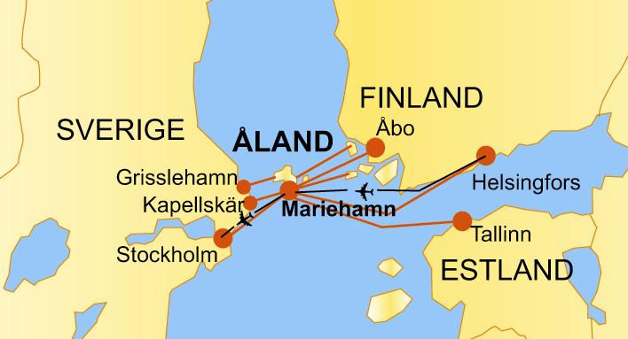
Åland Islands
Strategically located between several main Baltic Sea destinations

Slide 4
Town of Mariehamn
The only town in Åland, a small metropolis
11 263 inhabitants
11,6 km²
founded in 1861 by Tzar Alexander II at a time when Åland and Finland were a part of the Russian Empire. Mariehamn is named after Tzar Alexander’s wife, Maria Alexandrovna.

Slide 5
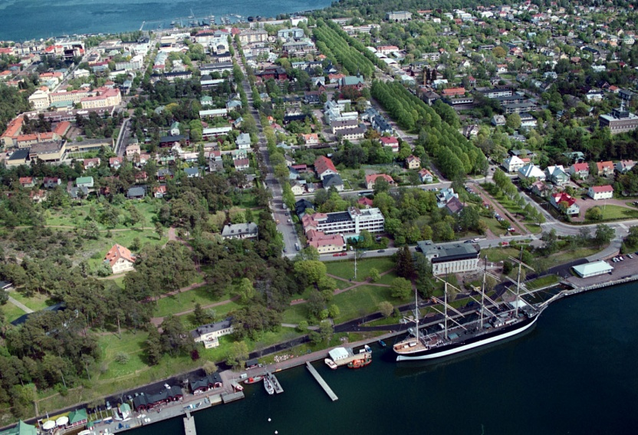
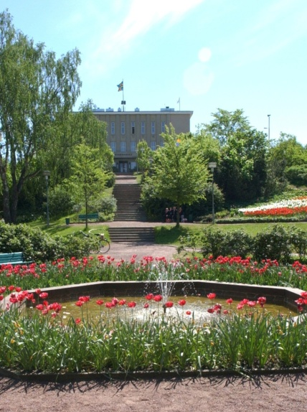

Slide 6
ONCE HOME PORT
FOR THE WORLD’S LARGEST
SHIPPING FLEET
Maritime museum
Museum ship Pommern
Maritime quarter

Slide 7
Åland Islands Peace Institute
The Åland Islands Peace Institute (ÅIPI) is a politically and religiously independent charitable foundation.
Its aim is to promote and support practical work as well as research in the broader area of peace and conflict resolution and from the vantage point of Åland and its unique status

Slide 8
Possible theme
'Empowerment for peaceful societies'.
- Strengthening networks of peaceful societies around the Baltic sea (the roles of civil society, minority protection, language diversity, mediation, conflict prevention, self-government etc)
Proactive and preventive work methods among young people for gender equality and against sexual violence

Slide 9
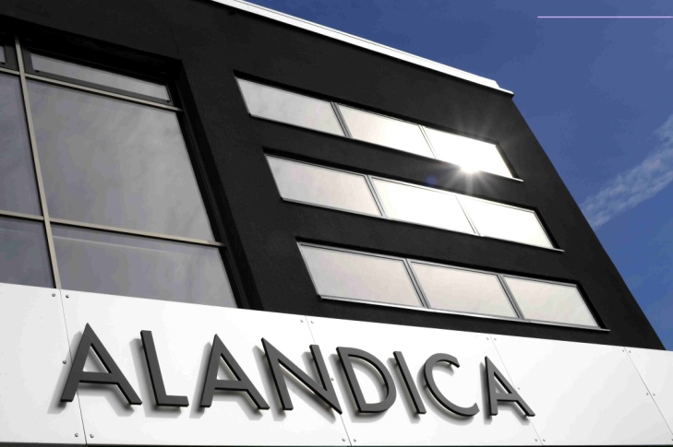

Slide 12
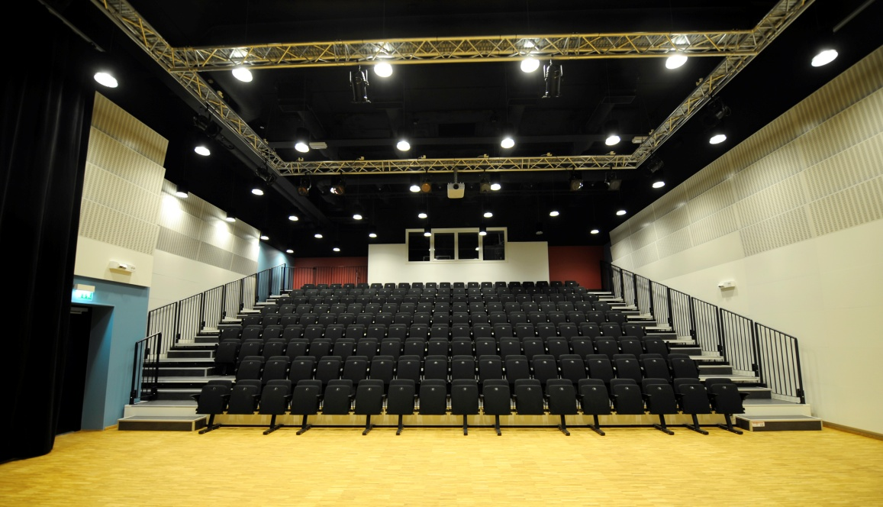

Slide 13
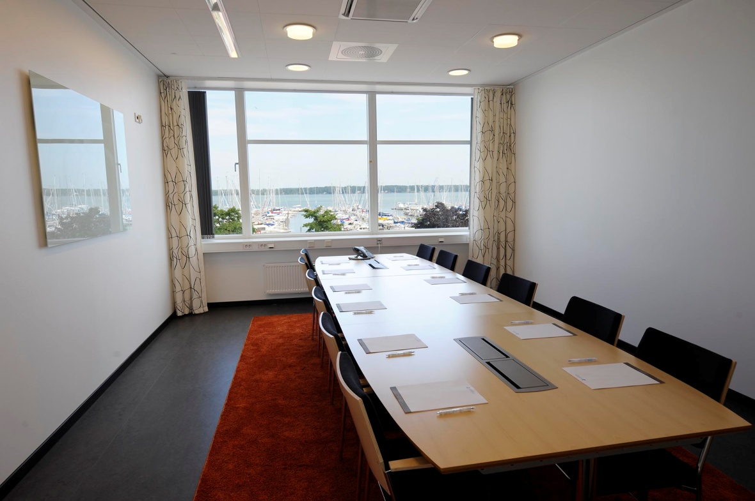

Slide 14
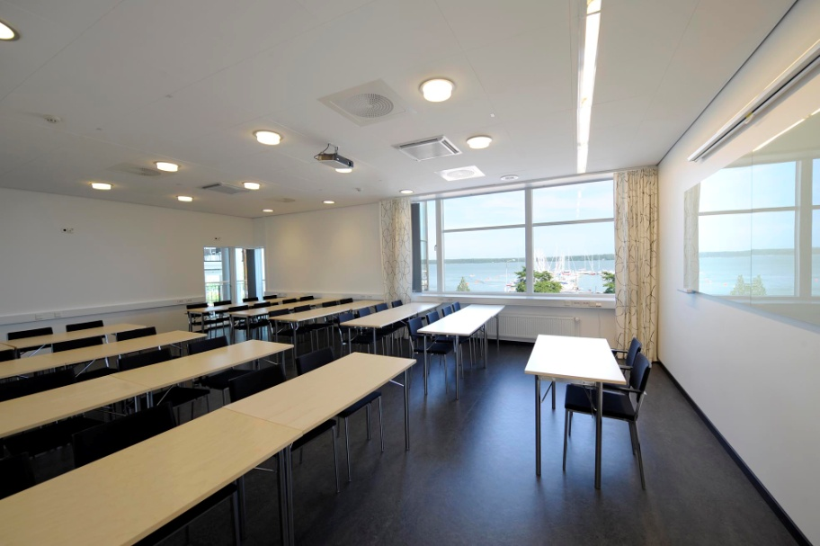

Slide 15
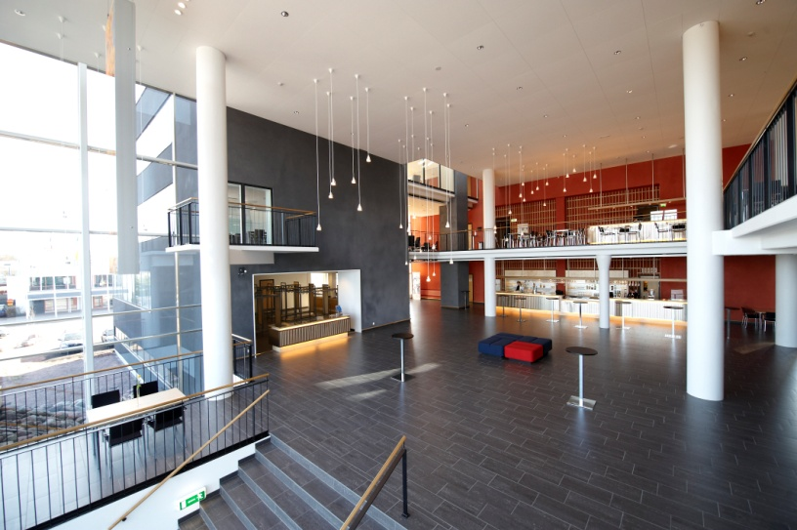

Slide 16
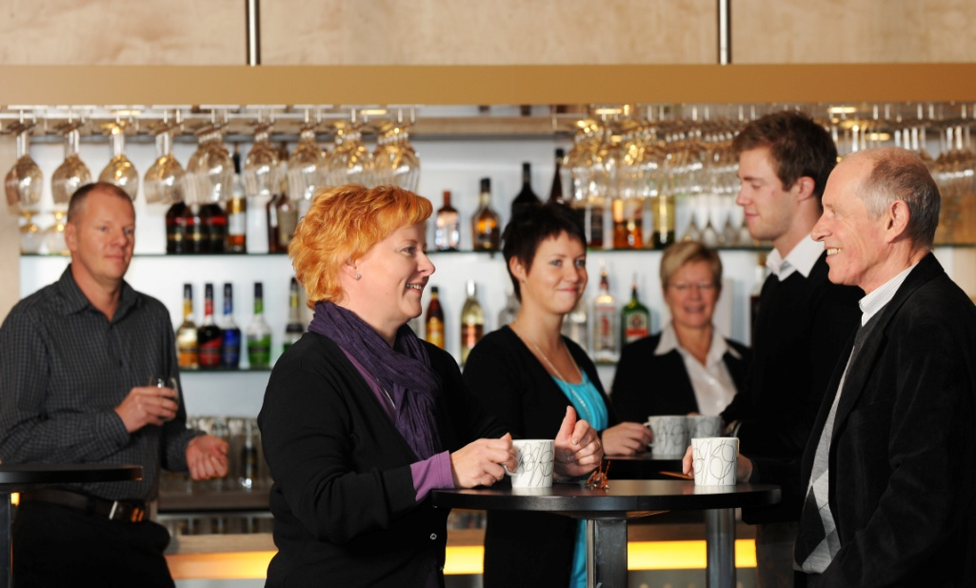

Slide 17
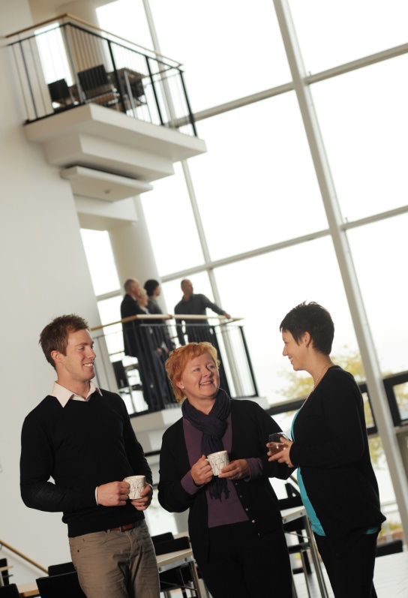

Slide 18
WELCOME TO MARIEHAMN!

