Slide 1
Commission on Tourism activity report Oct.`2011 – Oct.`2012
Koszalin, 04.10.2012

Slide 2
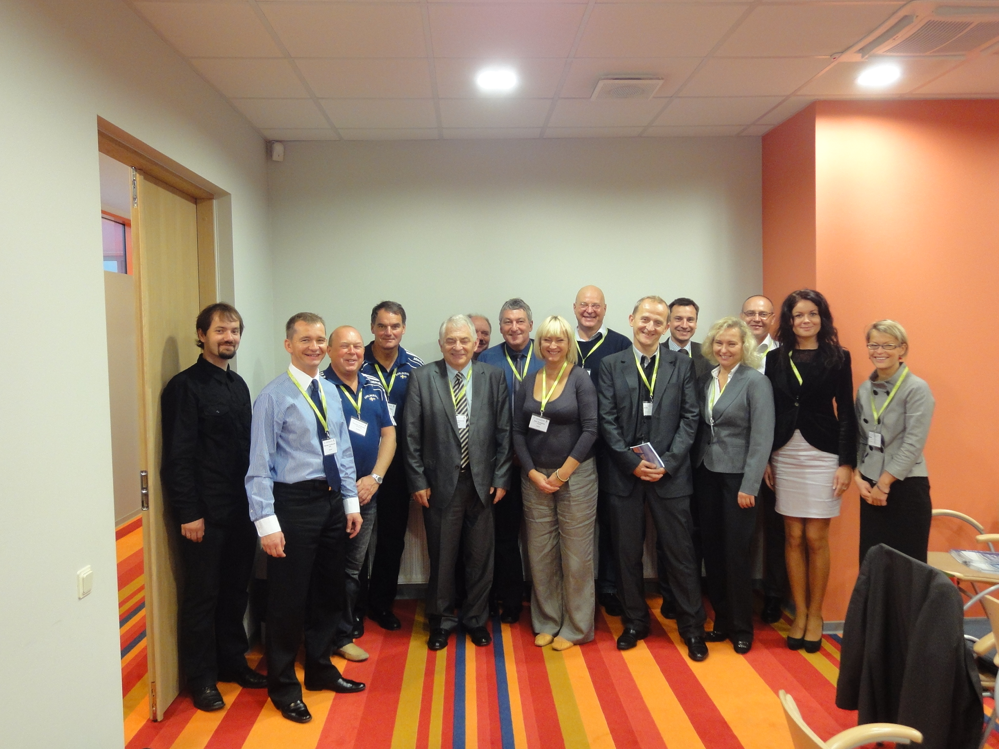
Commission on Tourism activity report
CoT meeting in Liepaja.
Commission on Tourism had it`s meeting on Oct. 6th 2011 in Liepaja, simultaneously with XI UBC General Conference.
We held an election of the Chairperson for the next two years, as well as we have discussed our plans and goals for the year 2012.

Slide 3
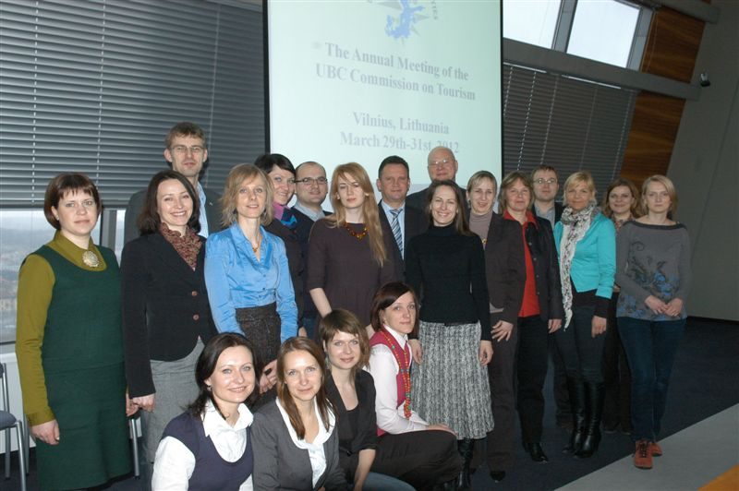
Commission on Tourism activity report
CoT meeting in Vilnius
The annual meeting of the UBC Commission on Tourism took place in Vilnius, Lithuania between 29 and 31 March 2012.
20 CoT members, guests and observers were welcomed by Mr. Jaroslav Kaminski, Deputy Mayor of the City of Vilnius.

Slide 4
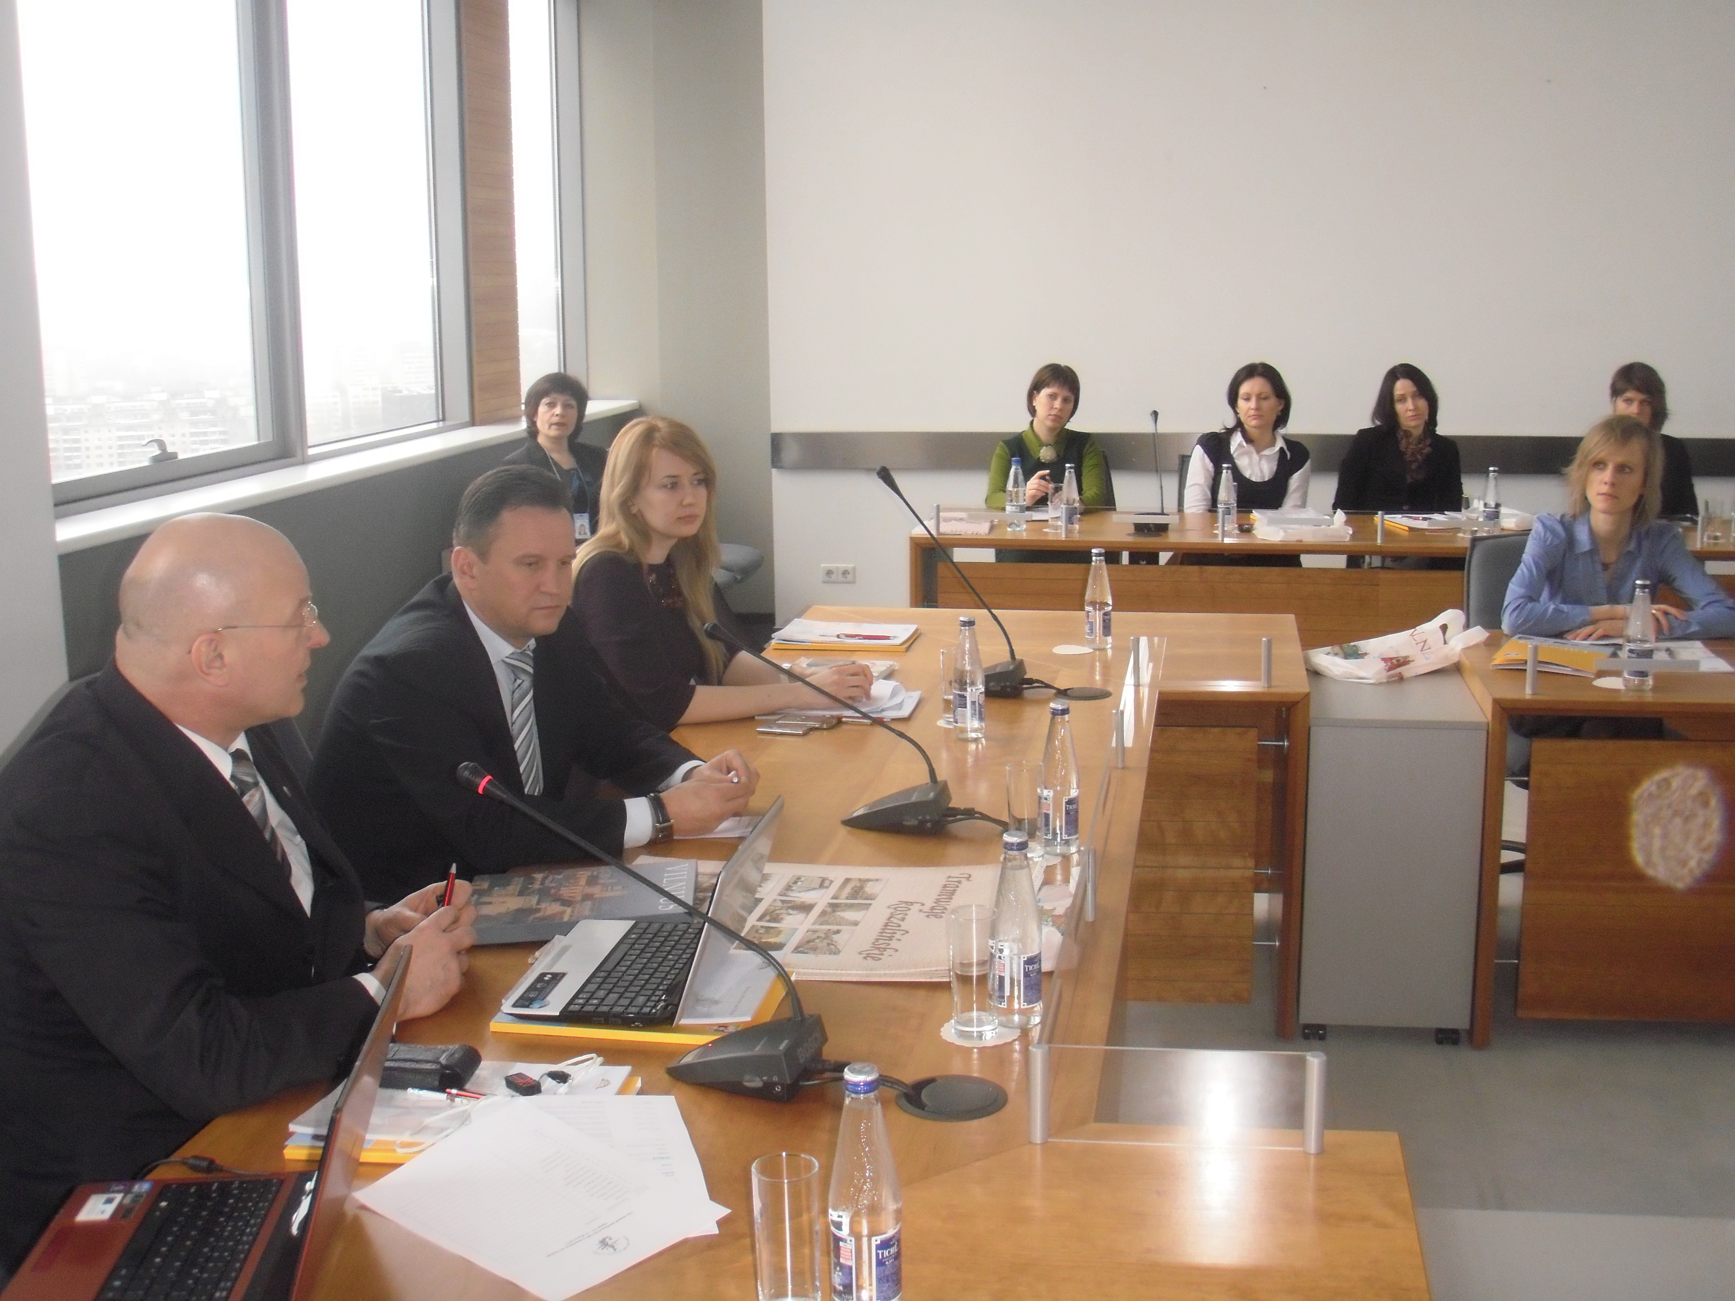
Commission on Tourism activity report
CoT meeting in Vilnius
„Baltic Sea Region – Perfect Tourism Zone“ –new eddition of the publication showing the tourist attractions of the cities within BSR was presented, as well as our two projects – AGORA 2.0 and „Enjoy South Baltic!”. We have also discussed the new concept - project "Baltic Culinary Route".

Slide 5
ENJOY SOUTH BALTIC!
Joint actions promoting the South Baltic area as a tourist destination
Part-financed by the European Union - European Regional Development Fund

Slide 6
ESB! is a new and innovatory cross-border project co-financed from European Development Funds within South Baltic Programme 2007-2013 implemented by partners form Poland, Lithuania and Germany:
Pomorskie Tourist Board (Lead Beneficiary)
Regional Self-Government of Pomorskie Region
Regional Development Agency of Koszalin
Mecklenburg-Vorpommern Tourist Board
Administration of Neringa Municipality
EUCC Baltic Office
Part-financed by the European Union - European Regional Development Fund

Slide 7
Project duration: 36 months (01.08.2011 – 31.07.2014)
Project budget: 1.180.540,00 EUR
ERDF: 1.003.459,00 EUR
The goal is:
To strengthen the image and competitiveness of the South Baltic region defined as the "rising star" among other international tourist destinations and to improve the quality of tourist offer and services throughout direct cooperation to private sector.
Part-financed by the European Union - European Regional Development Fund

Slide 8
The expected results are:
Creation of the new tourist product and packages on the base of unique resources and observed trends in tourism
Launching the new products on the market
Connection of south baltic tour operators and tourist agencies with the tourist industry in the perspective destination countries which communicate with the end custome
www.balticsea.travel
Part-financed by the European Union - European Regional Development Fund

Slide 9
The role of CoT/KARR is to promote and disseminate information about the project. Within the project implementation we will organize study tours and workshops for travel suppliers.
CoT/KARR is also responsible for preparation of information about cities, events and tourist attractions on Polish Pomerania Region. Gathered data will be published on the project web site.
Part-financed by the European Union - European Regional Development Fund

Slide 10
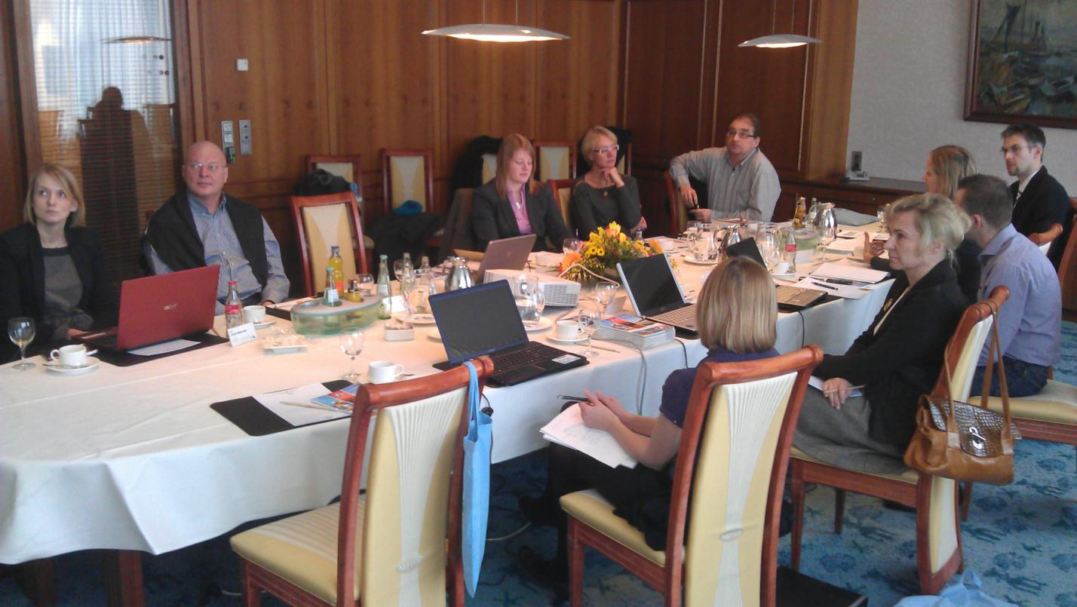
Partners meeting in Rostock
Second ESB meeting took place in Rostock, 05 – 07 February 2012. During this meeting the market research study results were presented. Furthermore, the web page - its structure and layout was broadly discussed.
Part-financed by the European Union - European Regional Development Fund

Slide 11
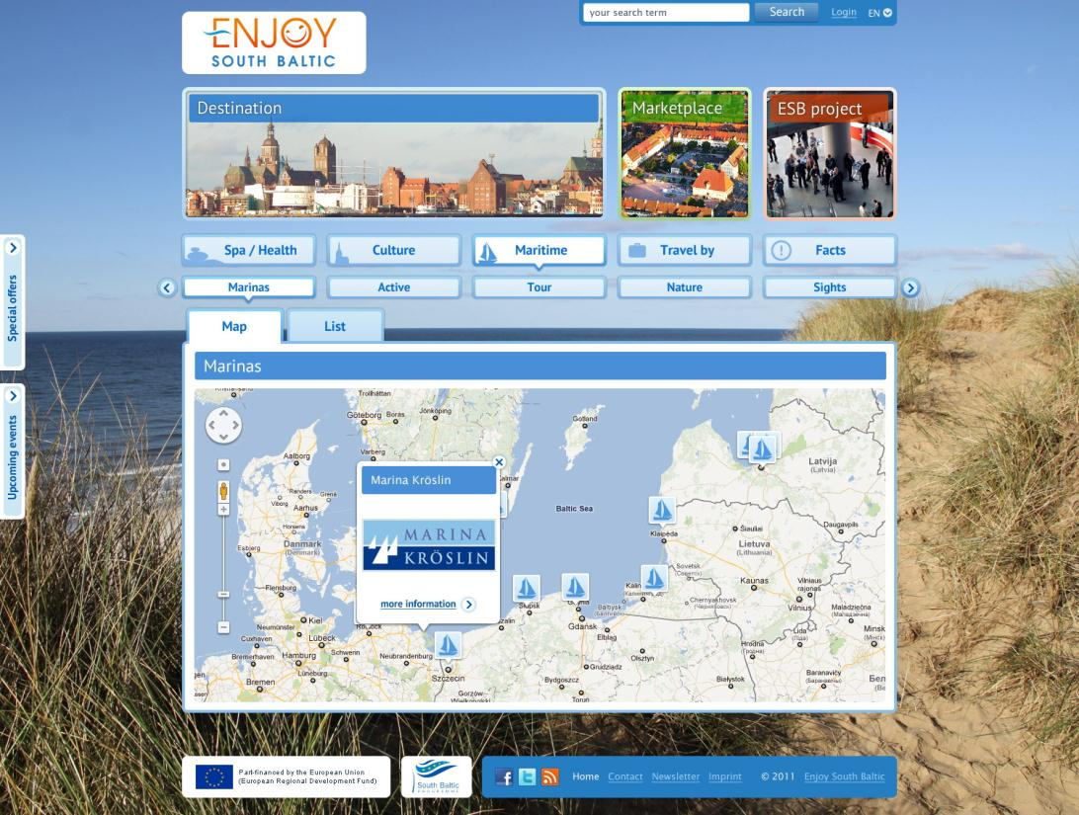
Part-financed by the European Union - European Regional Development Fund

Slide 12
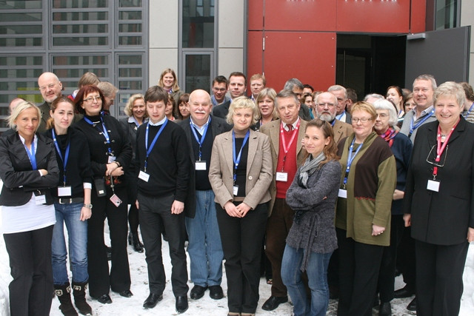
AGORA 2.0
Part-financed by the European
Union (European Regional
Development Fund and European Neighbourhood and Partnership Instrument)
Kick – Off Meeting
11 – 13 February 2010, Greifswald

Slide 13
Project in a nutshell Baltic Sea Region Programme 2007 – 2013 Priority 4 Attractive& Competitive Cities And Regions Duration 3 Years (Dec 2009 – Dec. 2012) Budget 2,834,054 EUR 24 Partners From 9 BSR Countries + Associated Partners From Russia (Kaliningrad)
Part-financed by the European
Union (European Regional
Development Fund and European Neighbourhood and Partnership Instrument)

Slide 14
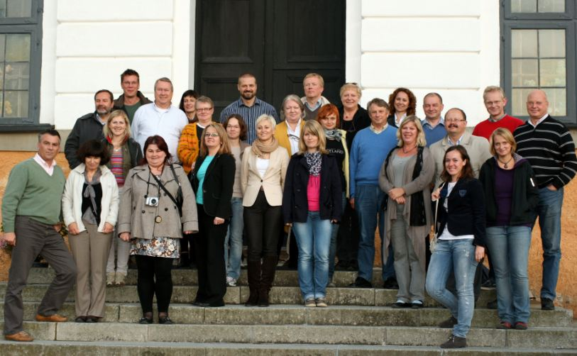
4th AGORA 2.0 Meeting
Stockholm / Skokloster, Sweden
29 September - 1 October 2011
Part-financed by the European
Union (European Regional
Development Fund and European Neighbourhood and Partnership Instrument)

Slide 15
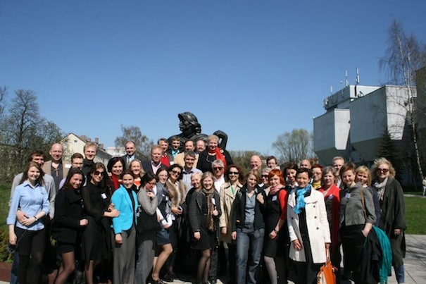
5th AGORA 2.0 Project Meeting
Kaliningrad, Russia
26 - 28 April 2012
Part-financed by the European
Union (European Regional
Development Fund and European Neighbourhood and Partnership Instrument)

Slide 16
CoT/KARR together with the National Foundation for Enterprise Culture in Gdynia and the Entrepreneurs’ Association in Rostock Region, as partners in the project, carried out online research and prepared survey for internet users.
The name of the questionnaire was “Survey on relevance of heritage potentials for business development”. Its aim was to assess the influence of various heritage aspects on tourism. We focused on natural and cultural heritage of the Baltic Sea Region.
The survey was available on the website of KARR, AGORA 2.0 project, facebook and was mailed to the cities of UBC. There are 201 responses on our survey. Now CoT/KARR is working on the development of research results.
Part-financed by the European
Union (European Regional
Development Fund and European Neighbourhood and Partnership Instrument)

Slide 17
CoT/KARR is also involved in The Six Baltic Sea Wonders Competition. The contest intends to promote the region’s cultural and natural heritage by identifying the most popular features of the whole Baltic Sea Region. The aim is to strengthen a common identity, which will help making the region more visible as a tourist destination and to develop innovative tourism products.
Who`s the winner?
Part-financed by the European
Union (European Regional
Development Fund and European Neighbourhood and Partnership Instrument)

Slide 18
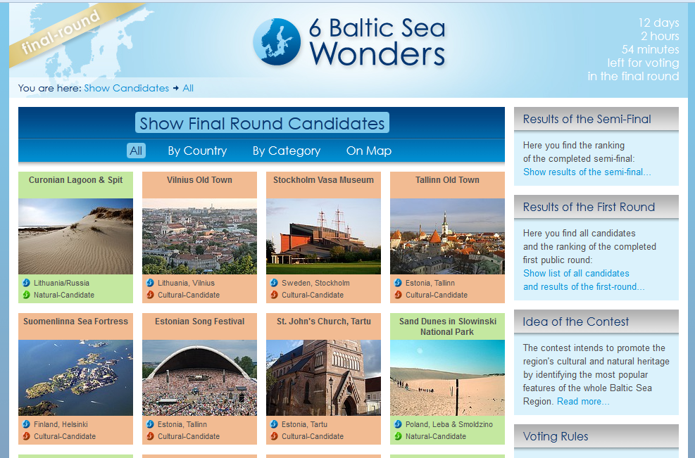
Part-financed by the European
Union (European Regional
Development Fund and European Neighbourhood and Partnership Instrument)

Slide 19
"Baltic Culinary Route - enjoy Baltic Cuisine"

Slide 20
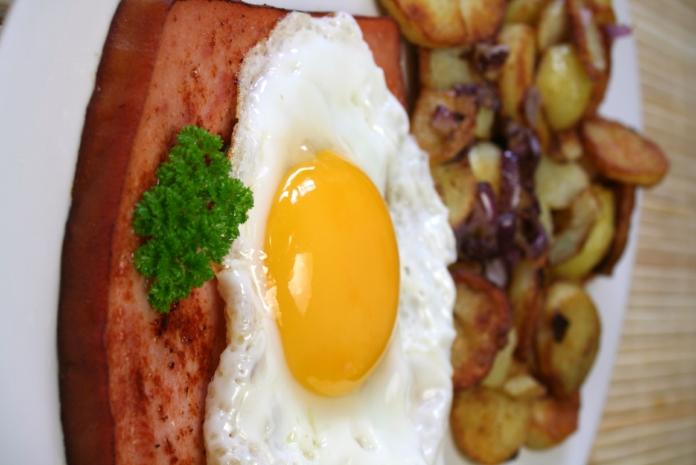
"Baltic Culinary Route - enjoy Baltic Cuisine"
The aims of the project:
preparation of the final tourist product with the involvement of the UBC member cities;
creation and promotion of the concept of "Baltic Cuisine";
promotion of the Baltic Sea Region, its traditions, customs and current tourist offer

Slide 21
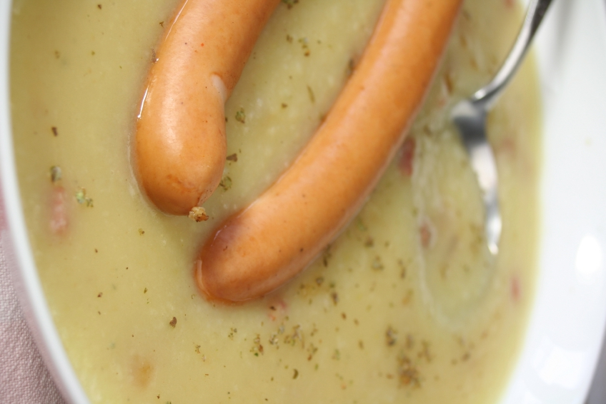
"Baltic Culinary Route - enjoy Baltic Cuisine"
The project will be implemented in the period February 2012 - March 2013, and its various stages look like this:
Introductory stage of information - mailing to UBC member cities with information about the project;
Gathering information about the culinary traditions of each BSR country - cooperation within CoT and between UBC member cities;
Creating a logo of the Baltic Culinary Route and Marketing Plan for BCR.

Slide 22
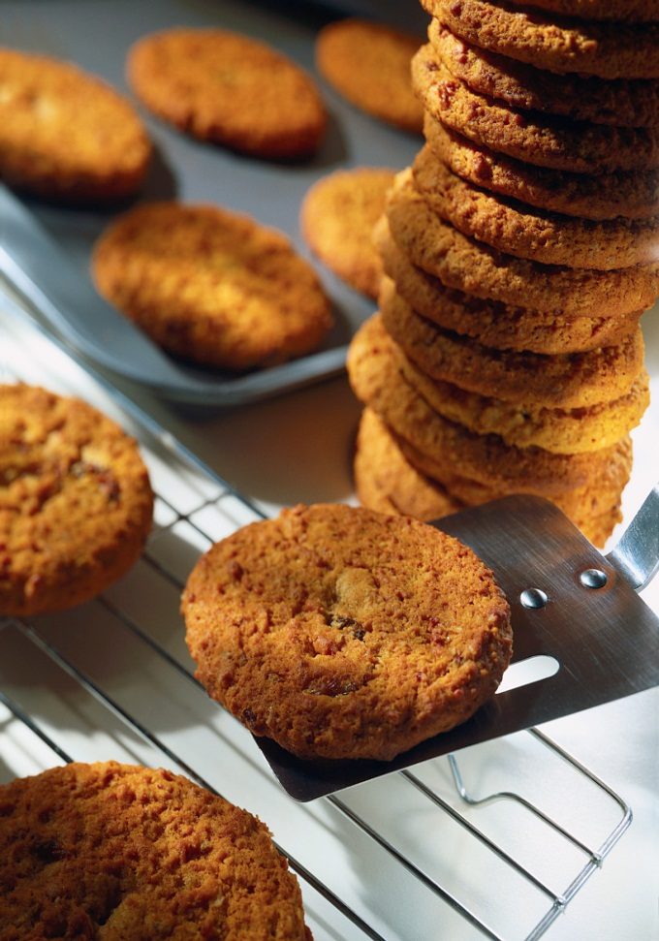
"Baltic Culinary Route - enjoy Baltic Cuisine"
Creation of geographical and biological description of the Baltic Sea Region with particular reference to the influence of natural conditions on the culinary heritage
Selection of the food and places where it is served to be included in the project - indications made by member cities of UBC
Preliminary delimitation of BCR on the basis of collected information

Slide 23
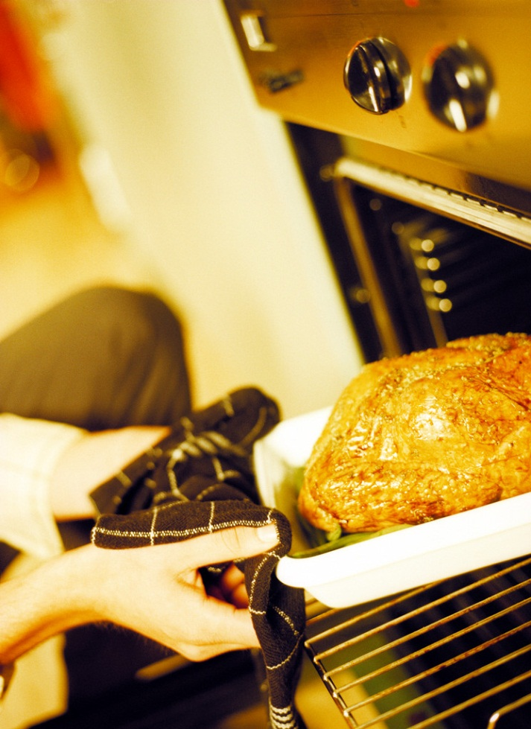
"Baltic Culinary Route - enjoy Baltic Cuisine"
Development of the final version of BCR with multimedia material. Elaboration and edition of data and preparing it for printing
Preparing an electronic version of guide on BCR to be used on the Internet (in English)
Providing the UBC member cities and structures of UBC with the electronic version of the guide on BCR with the request to place it on their web sites
Printing out the booklet of Baltic Culinary Route

Slide 24
"Baltic Culinary Route - enjoy Baltic Cuisine"
We assume that the CoT should look at the annual updating of data in the guide on BCR in collaboration with Commission Members and UBC member cities.
The Guide will be regularly updated with interesting facts and anecdotes about places along the route. The Commission will also collect unique recipes for local dishes and in this way will save them from forgetting.

Slide 25
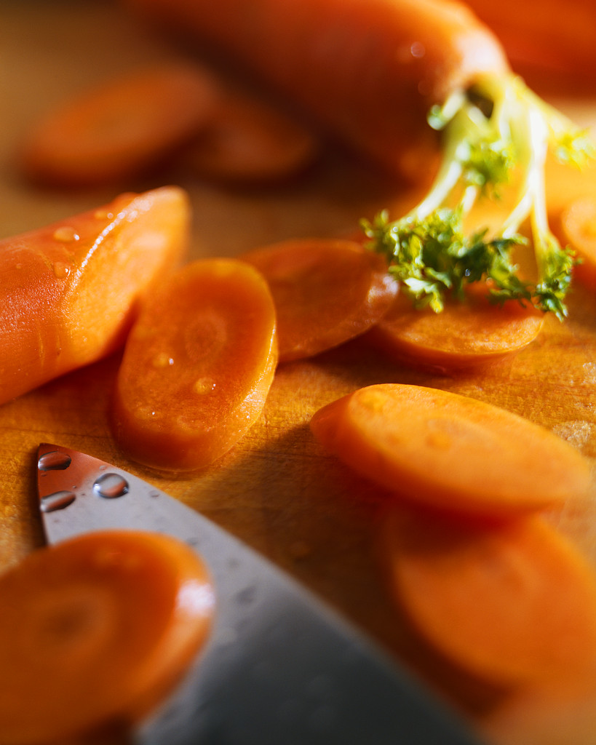
"Baltic Culinary Route - enjoy Baltic Cuisine"
The planned project will help in creating and promoting the concept of "Baltic Cuisine".
The results of this project will be used by the CoT in the projects „AGORA 2.0” and „Enjoy South Baltic!”, and will be available for own and foreign publications.
It is anticipated that, over time, the guide on BCR will be translated into national languages ​​of the Baltic Region countries.

Slide 26
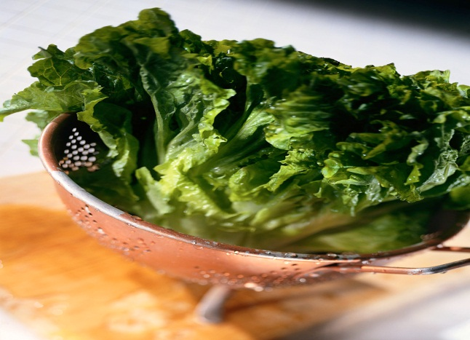
"Baltic Culinary Route - enjoy Baltic Cuisine"
Thank you for your attention!

